Slide 1
Vasha Shikkha
Presentation on Mock UI
CSE-326
Group: 4 (A1)
1705007-1705013-1705018 -1705021-1705023-1705025

Slide 2


Modules
There are mainly 2 modules in our project
Admin
User

Slide 3
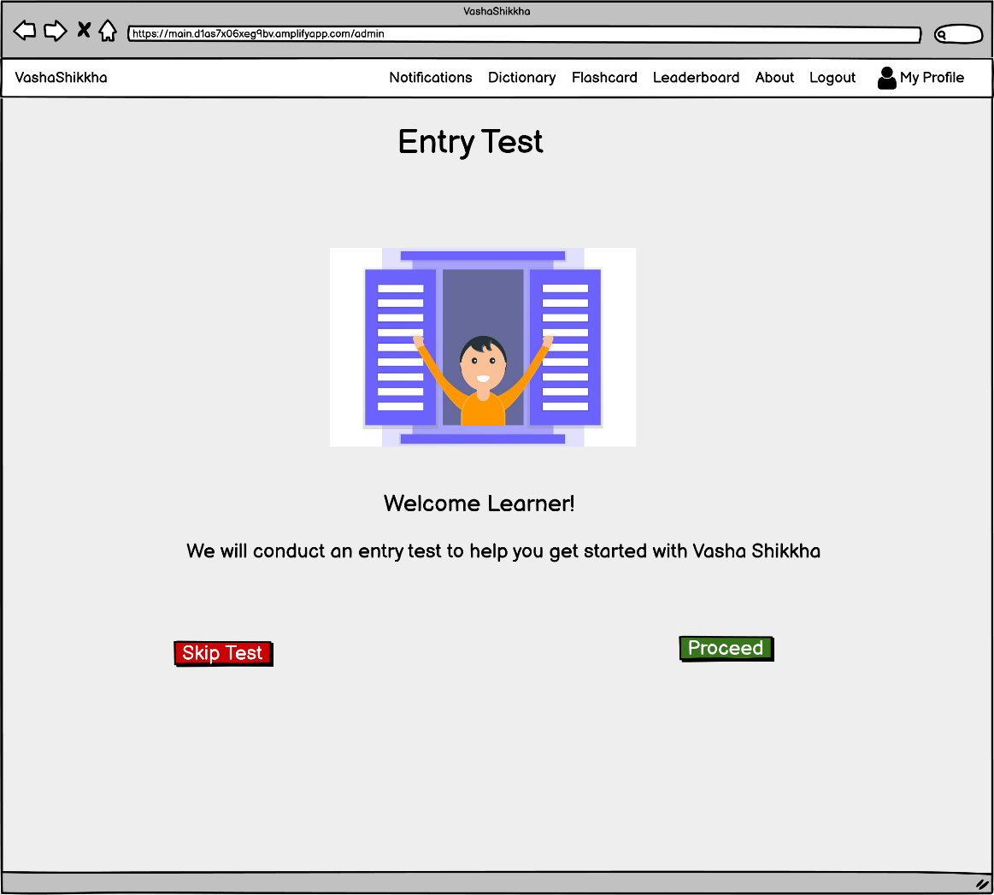
Entry Test

Slide 4
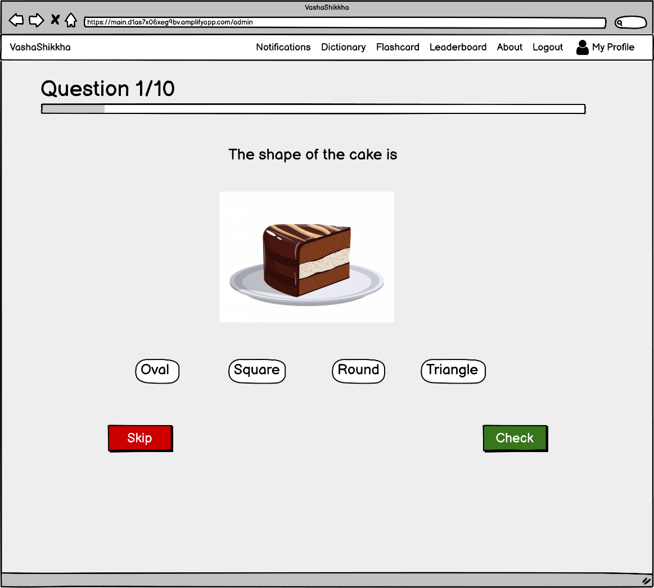
Entry Test

Slide 5
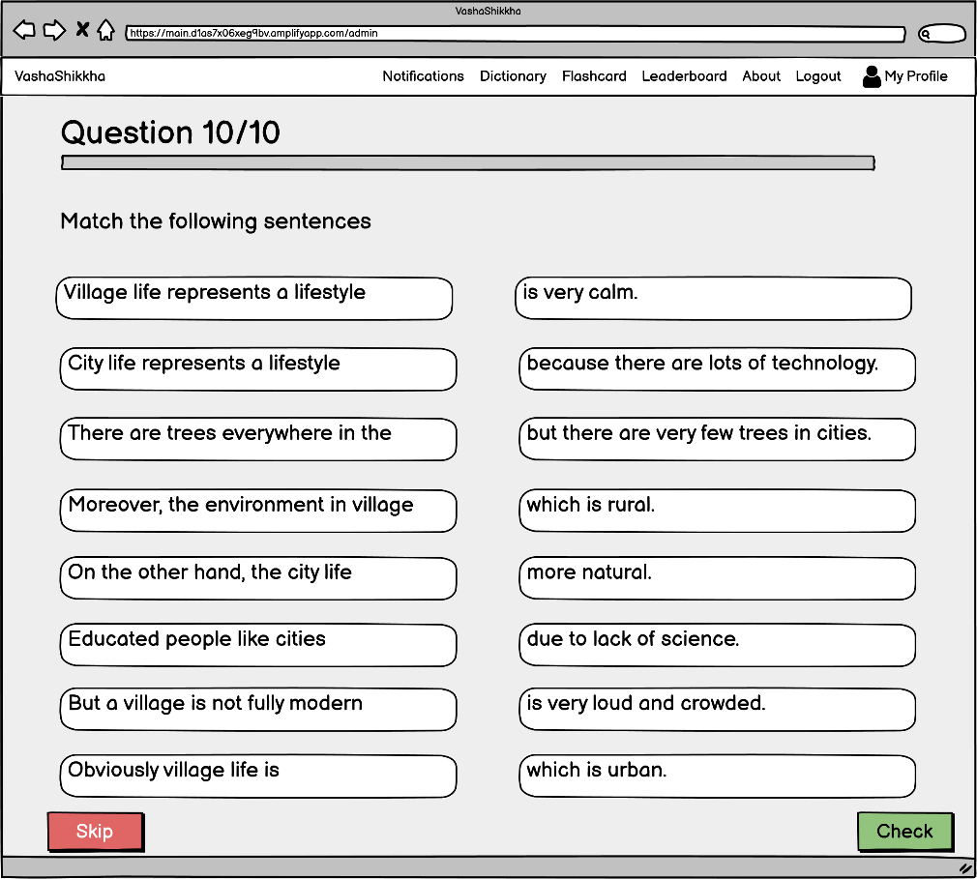
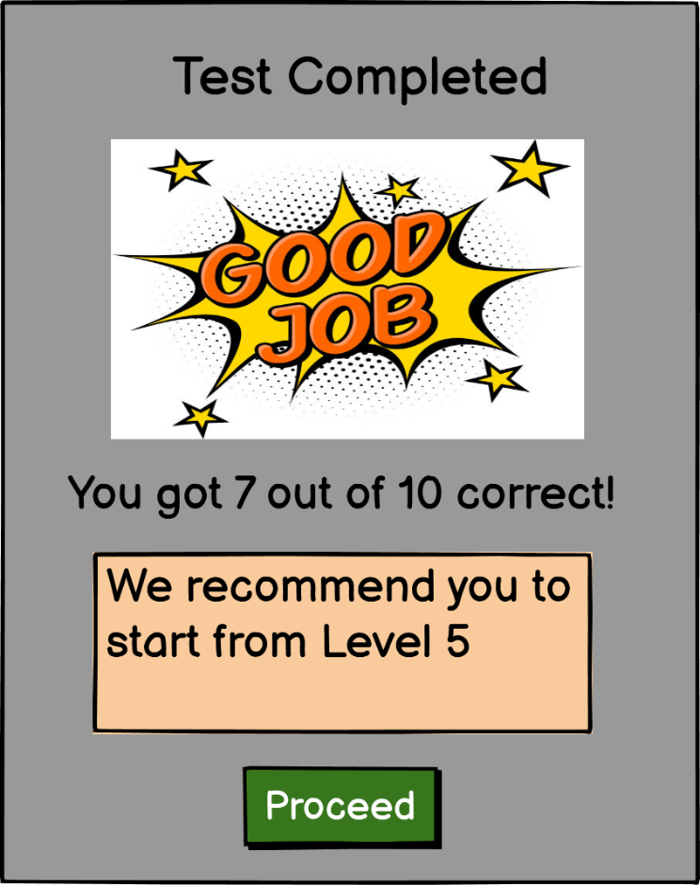
Entry Test

Slide 6
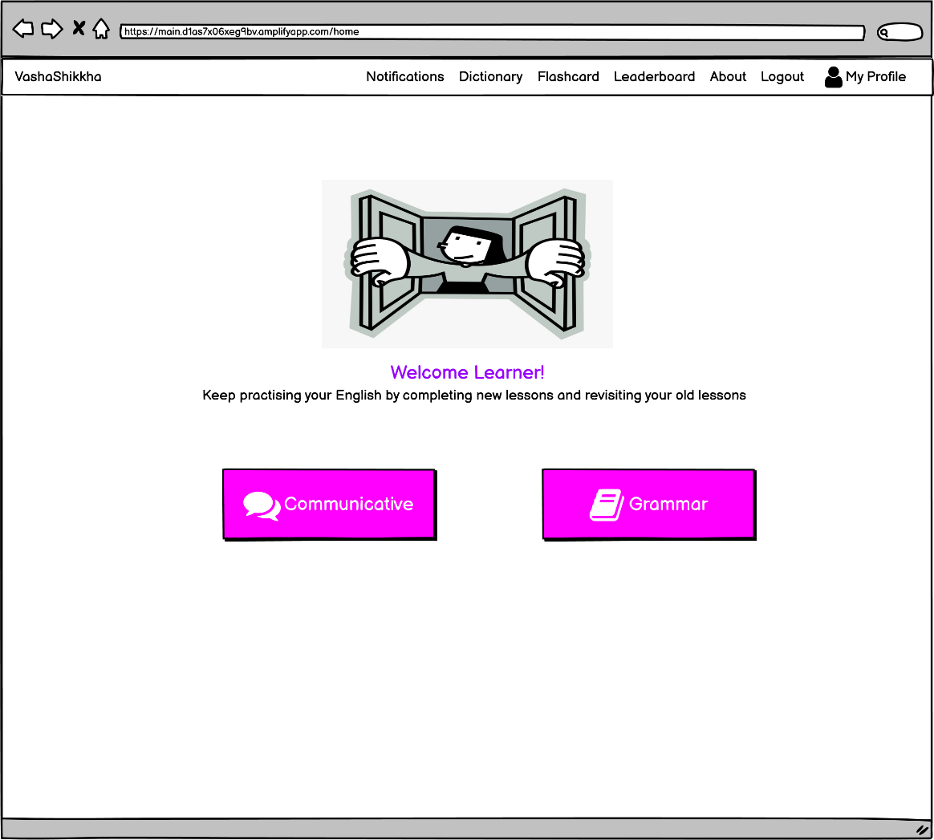
Home Page

Slide 7
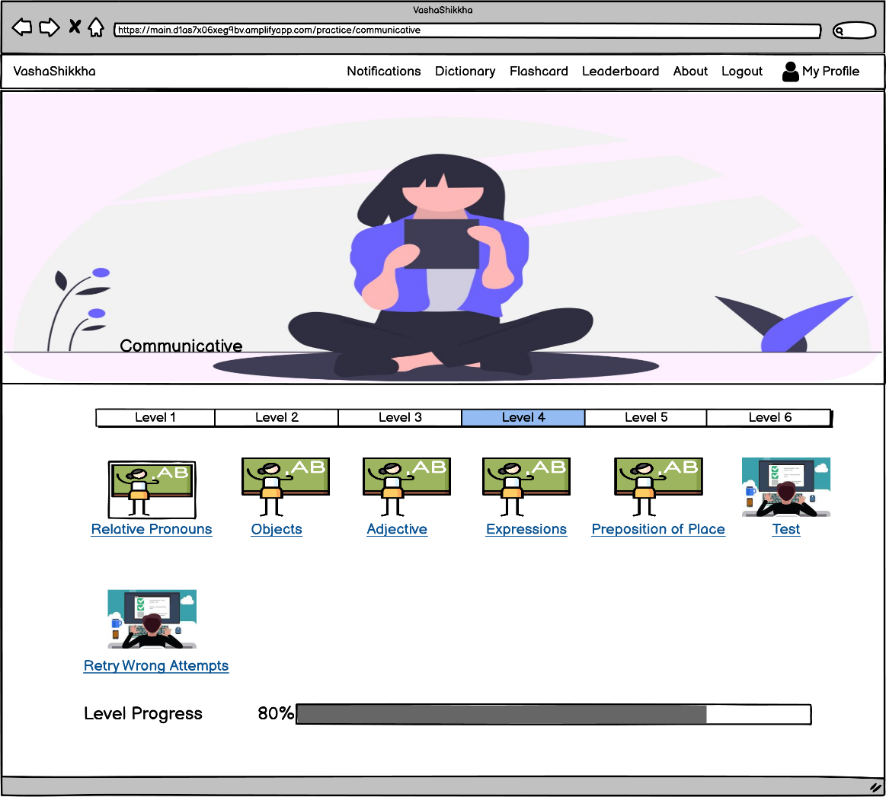
All Levels

Slide 8
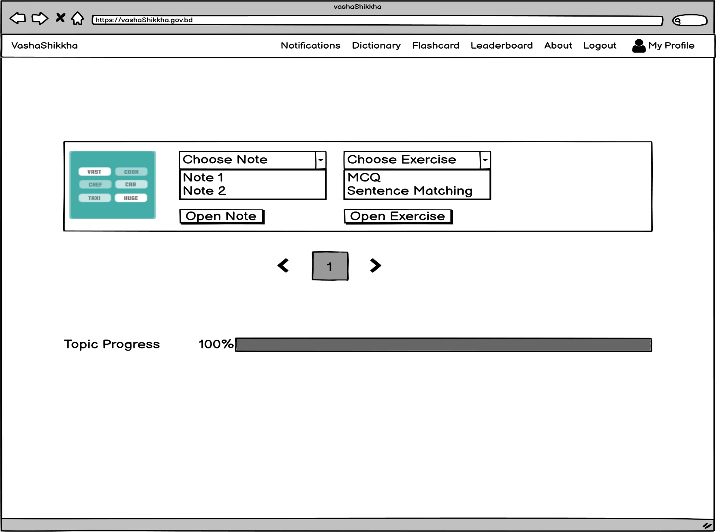
Topic : Exercise

Slide 9
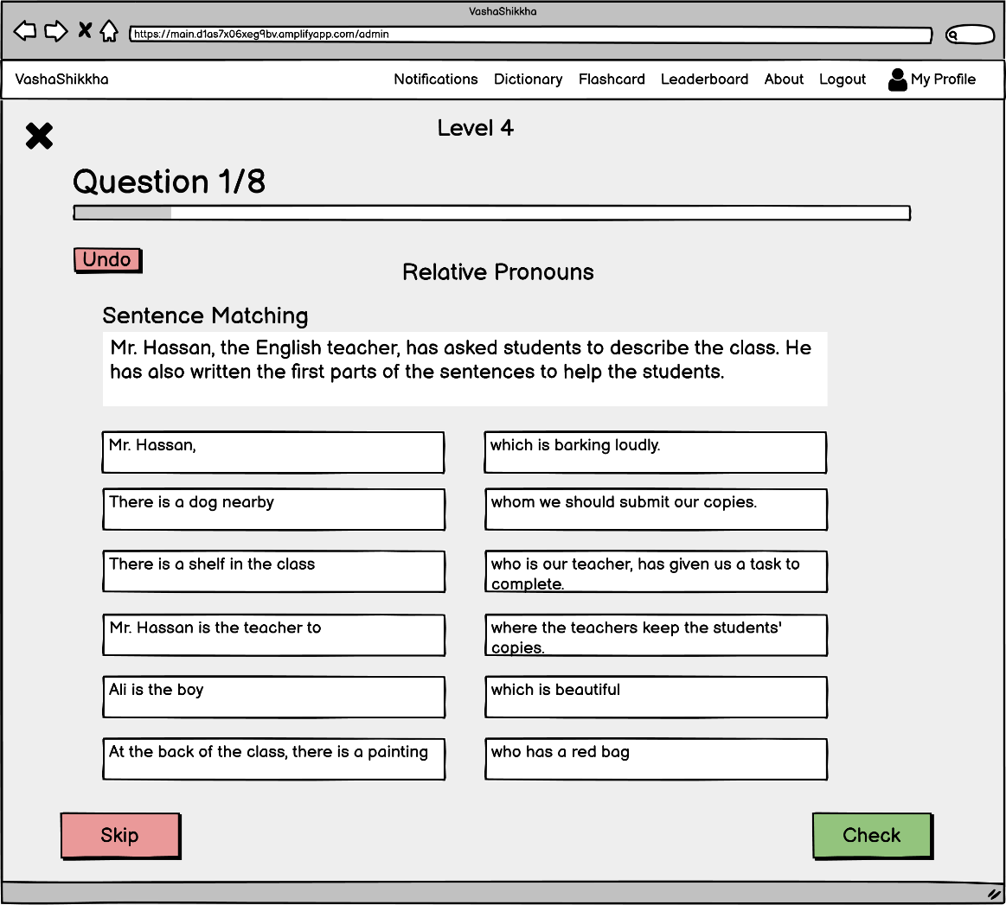
Lesson Exercise

Slide 10

Topic : Note

Slide 11
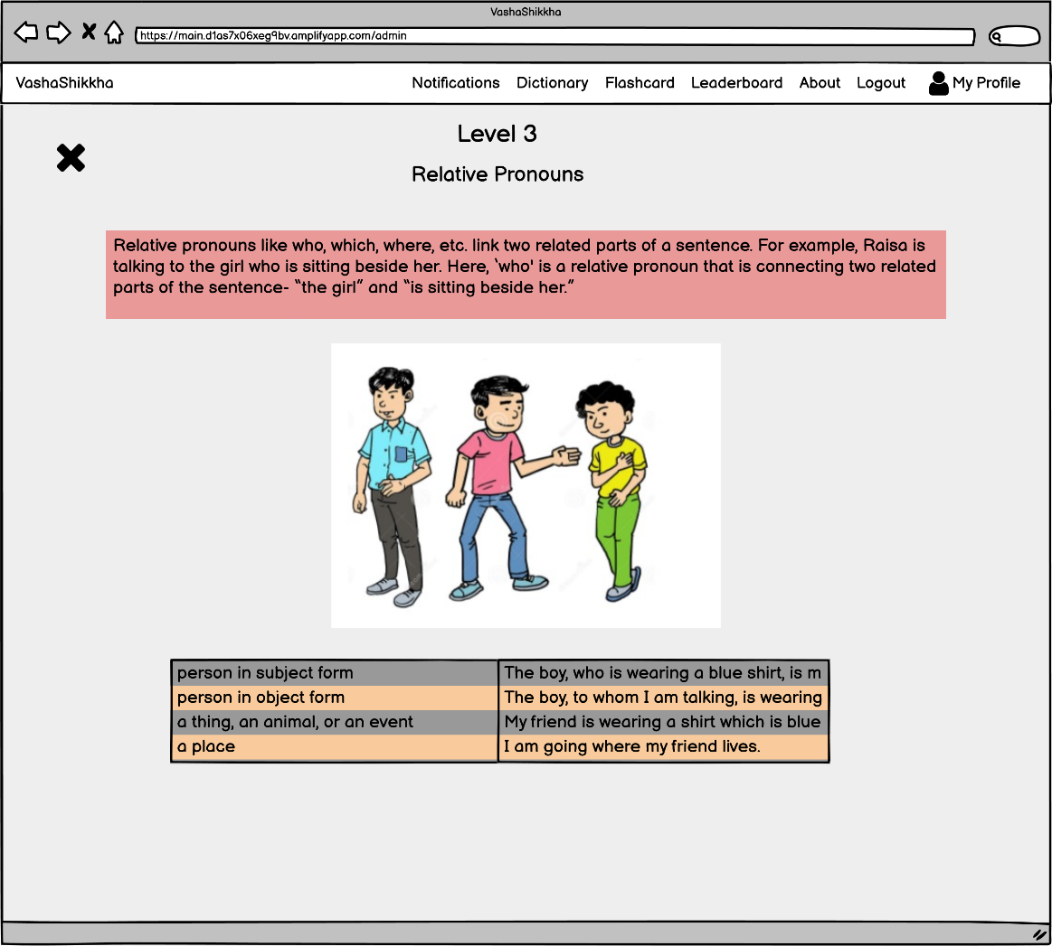
Note

Slide 12
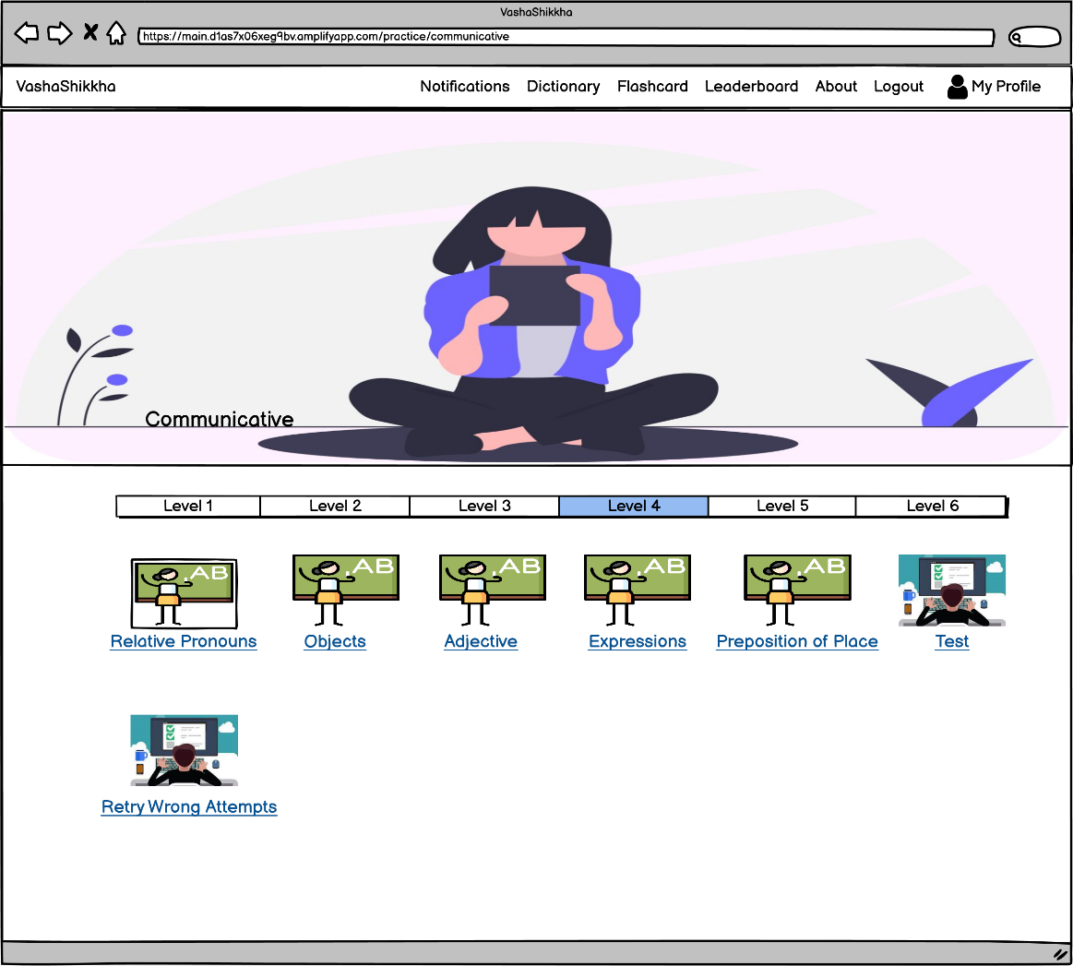
Retry Wrong Attempts : Levelwise

Slide 13
Retry Wrong Attempts : Levelwise

Slide 14
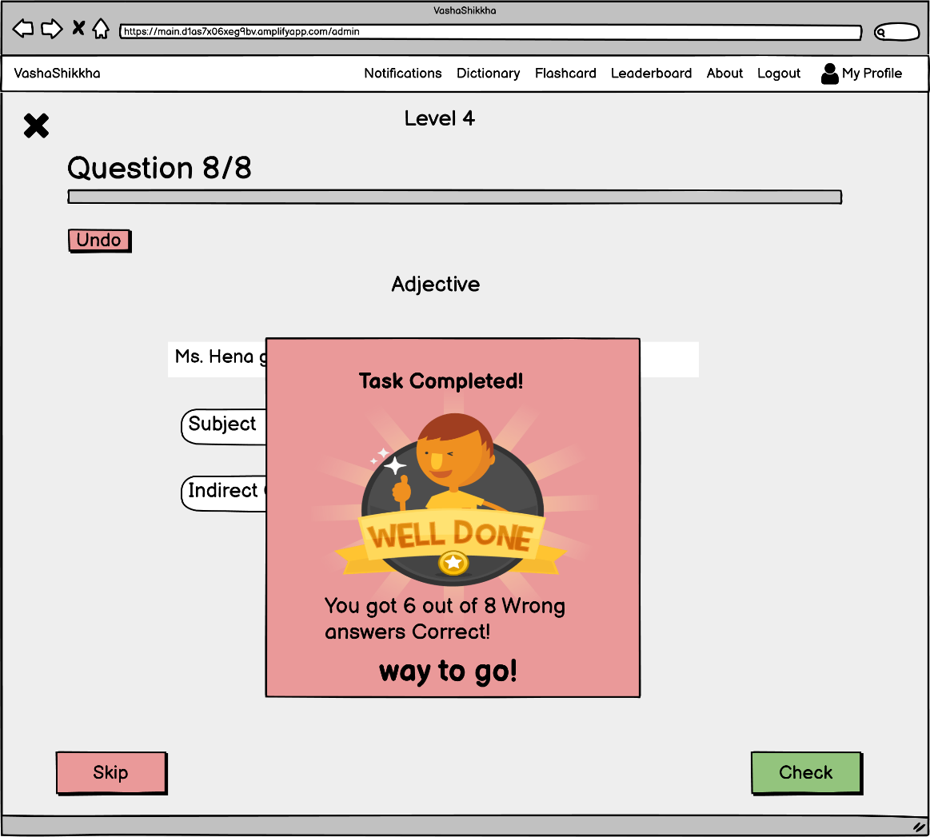
Retry Wrong Attempts : Levelwise

Slide 15
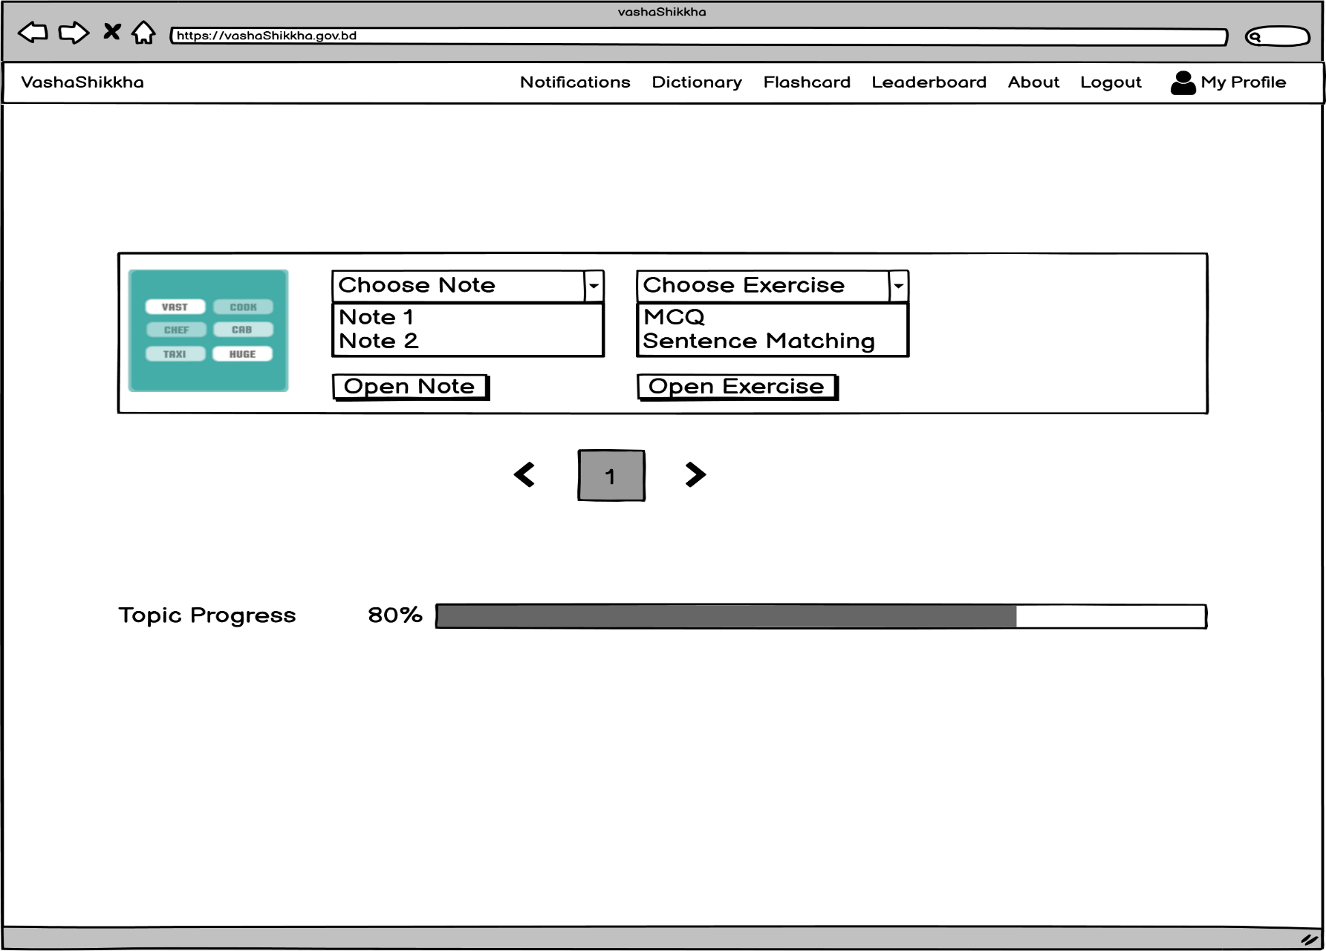
Retry Wrong Attempts : Topicwise

Slide 16
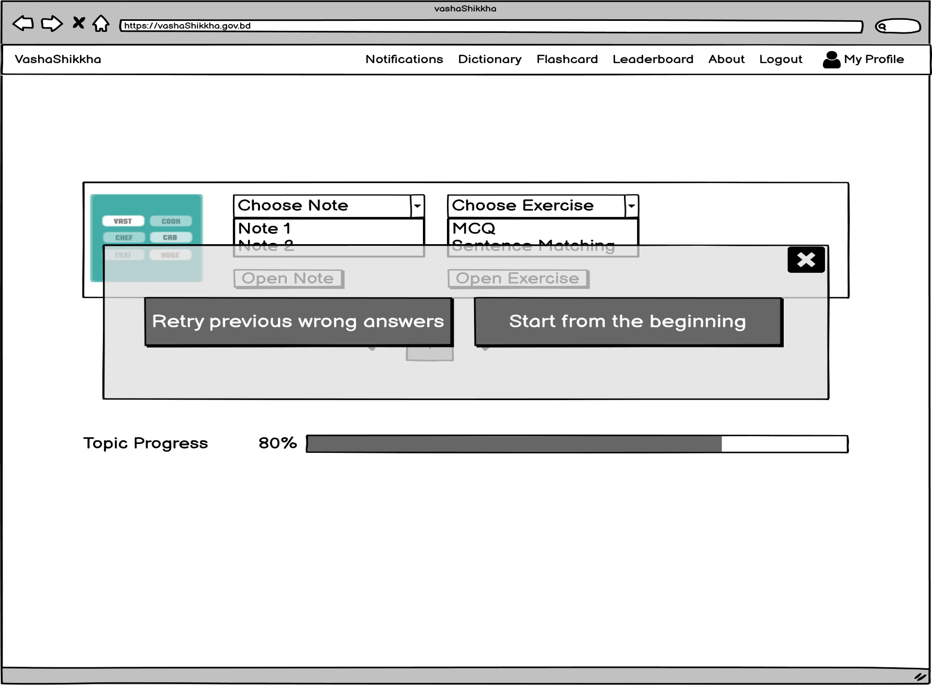
Retry Wrong Attempts : Topicwise

Slide 17
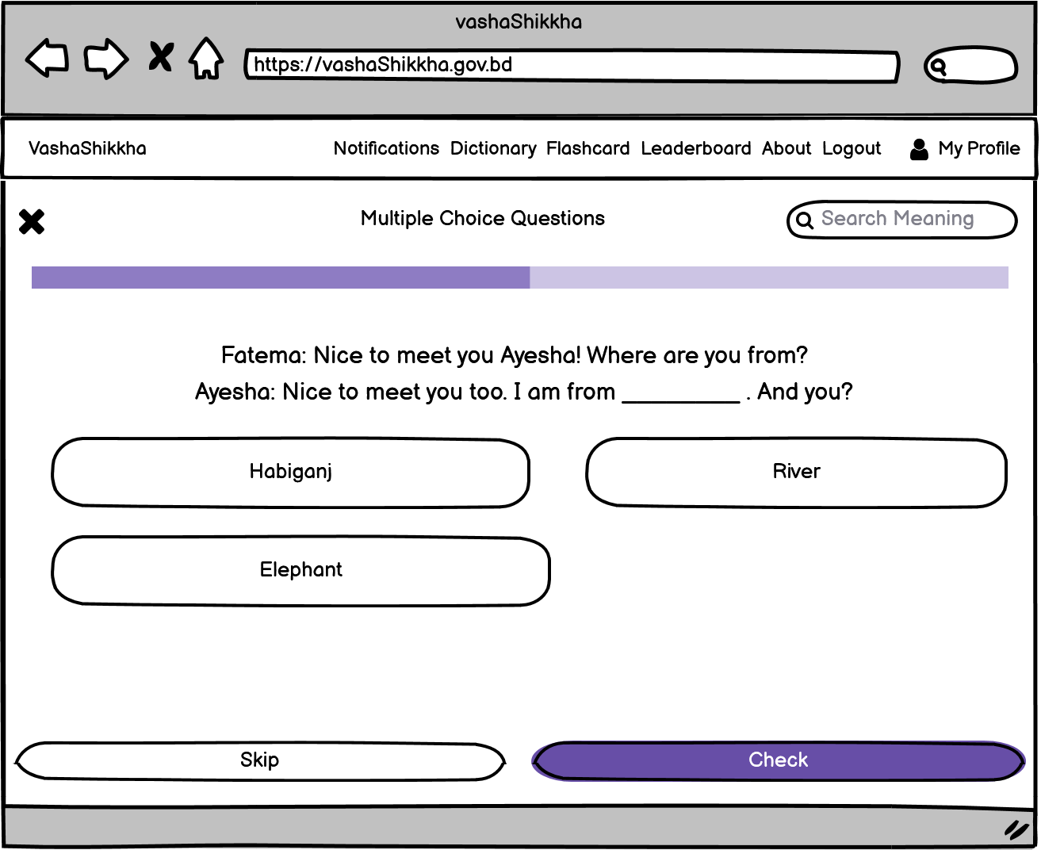
Retry Wrong Attempts : Topicwise

Slide 18
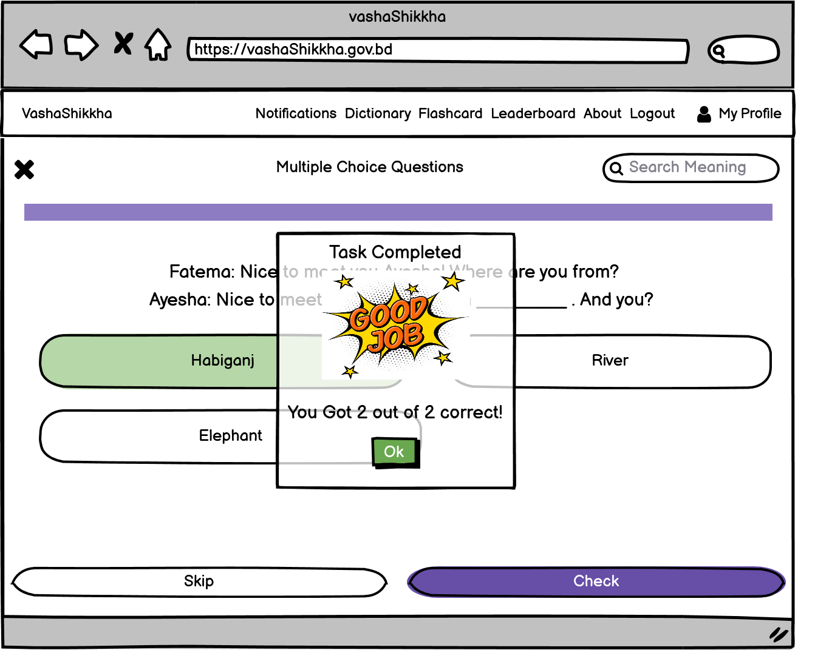
Retry Wrong Attempts : Topicwise

Slide 19
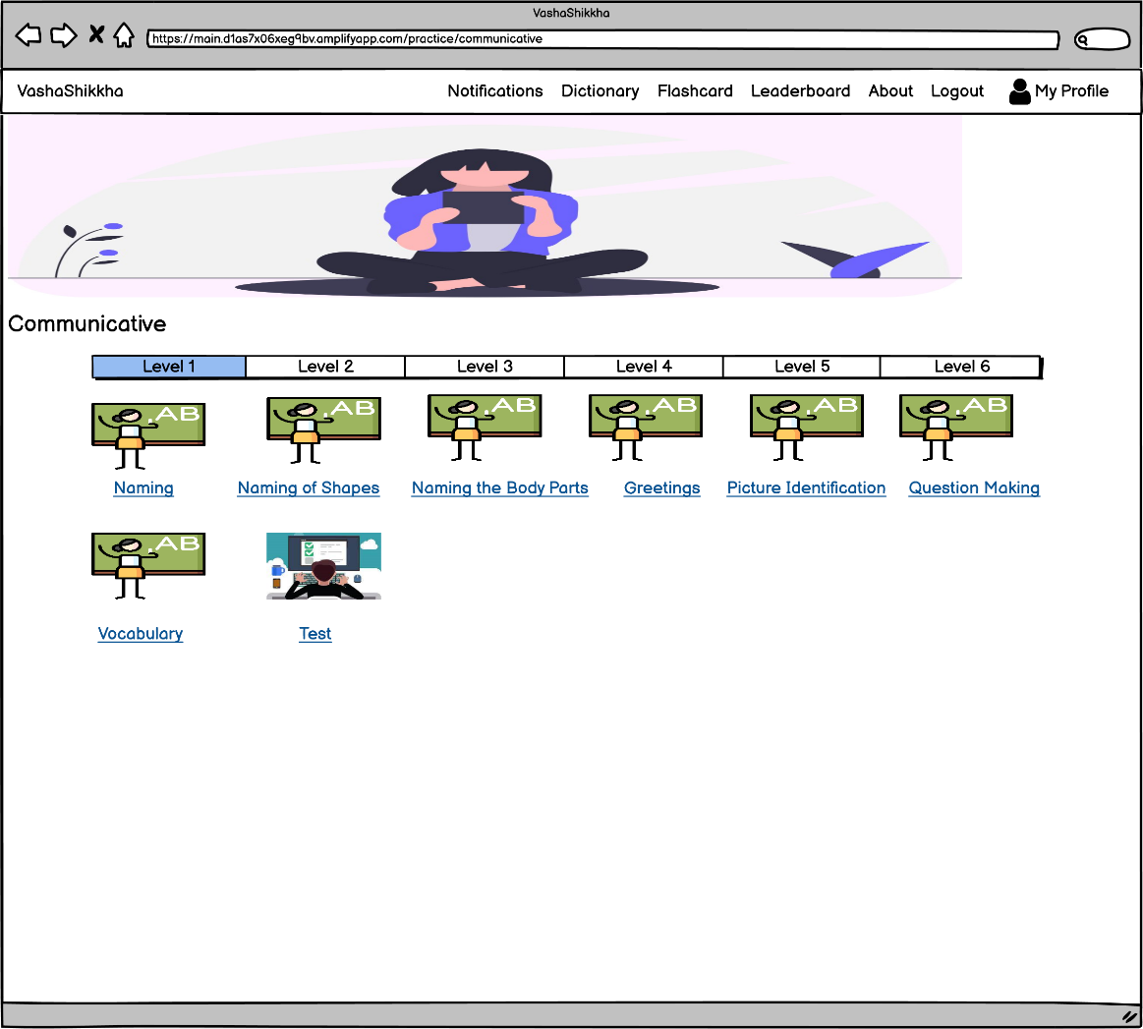
Level Based Test

Slide 20
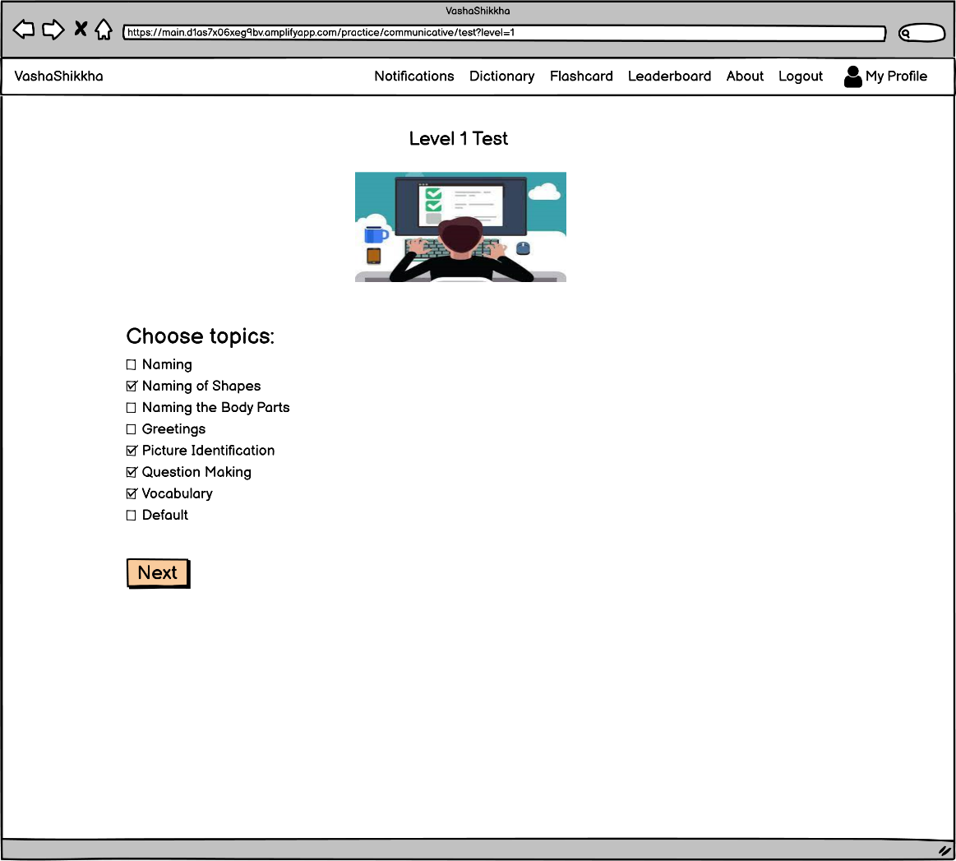
Level Based Test : Topic Choosing

Slide 21
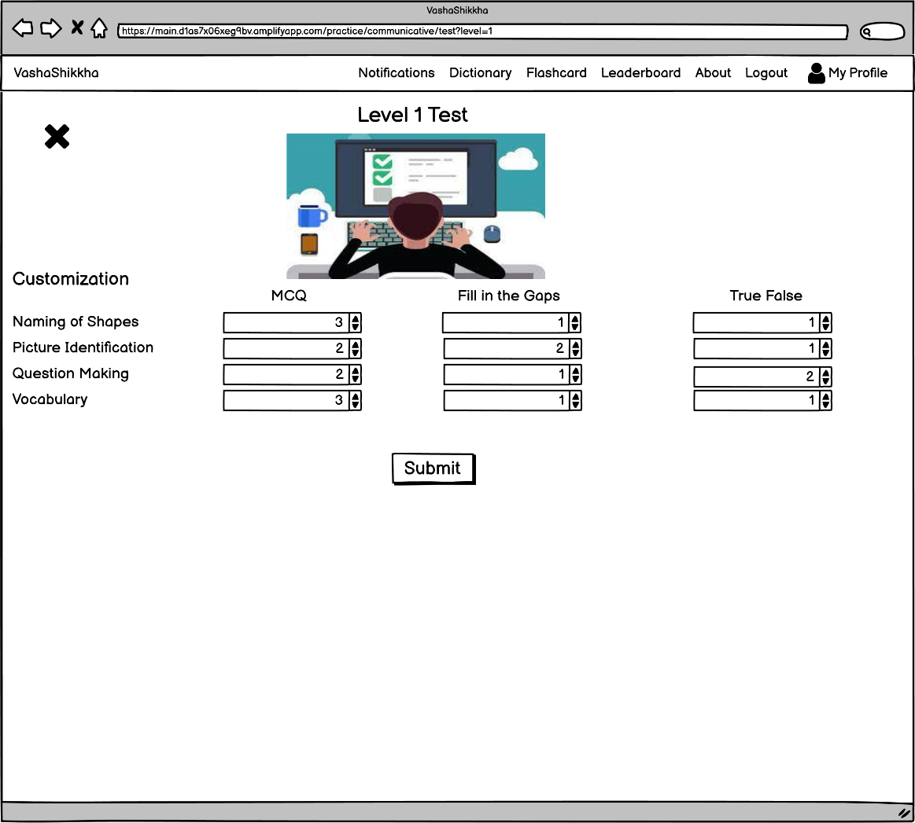
Level Based Test : Customization

Slide 22
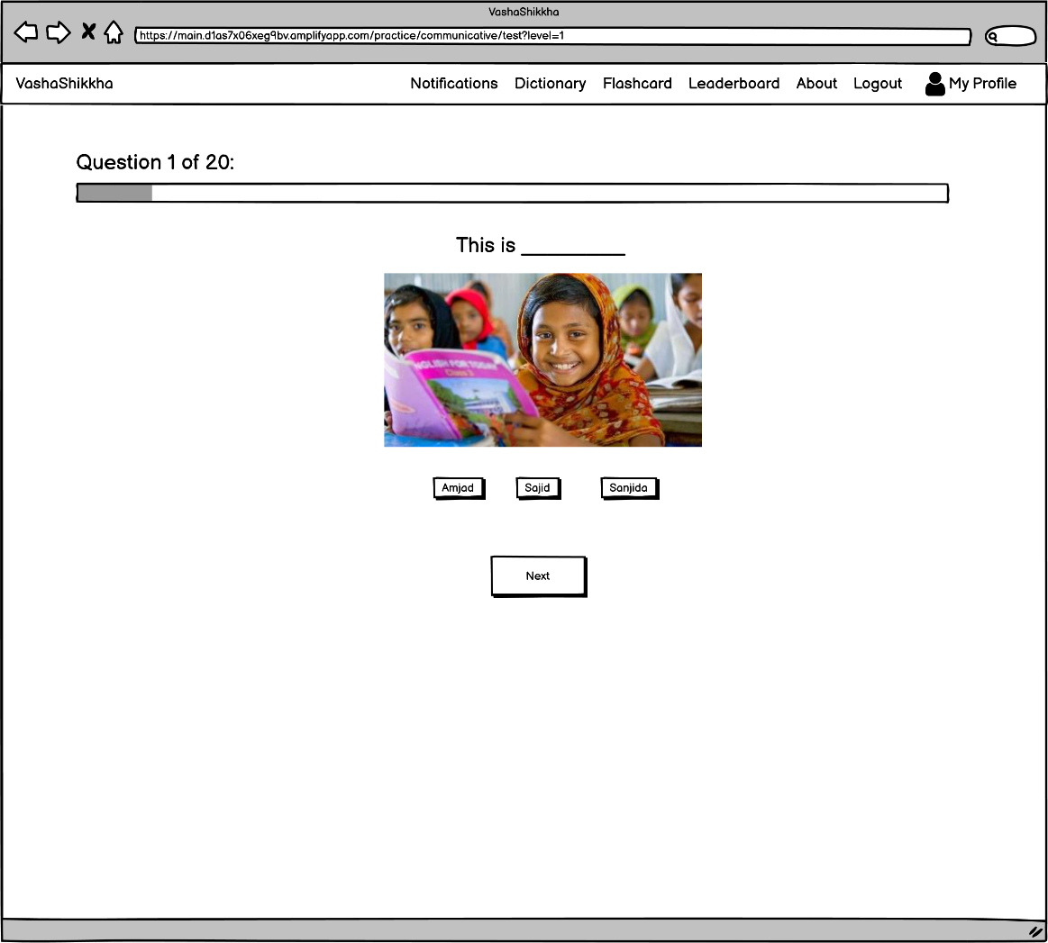
Level Based Test

Slide 23
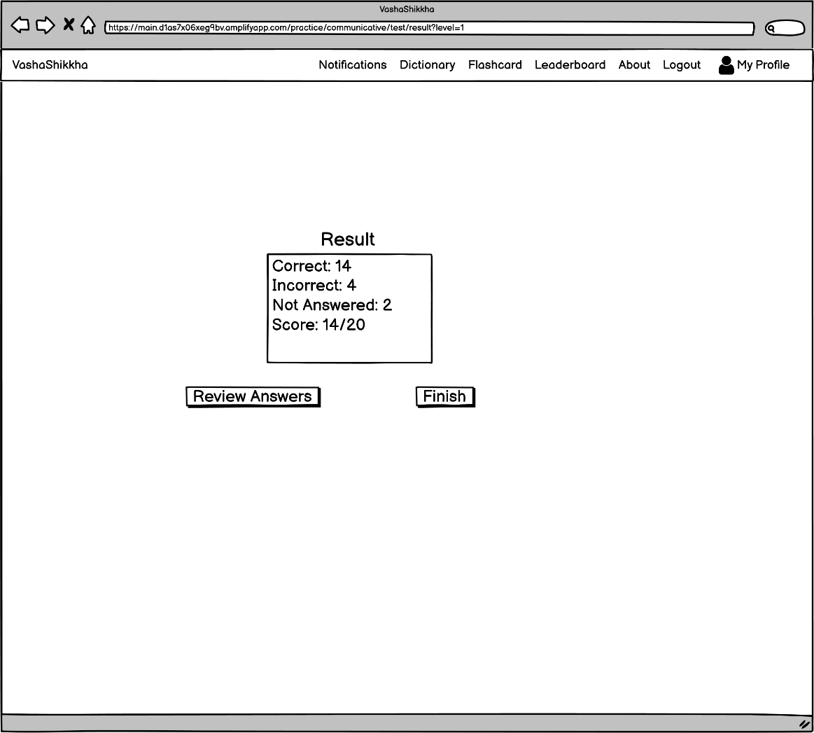
Level Based Test : Result

Slide 24
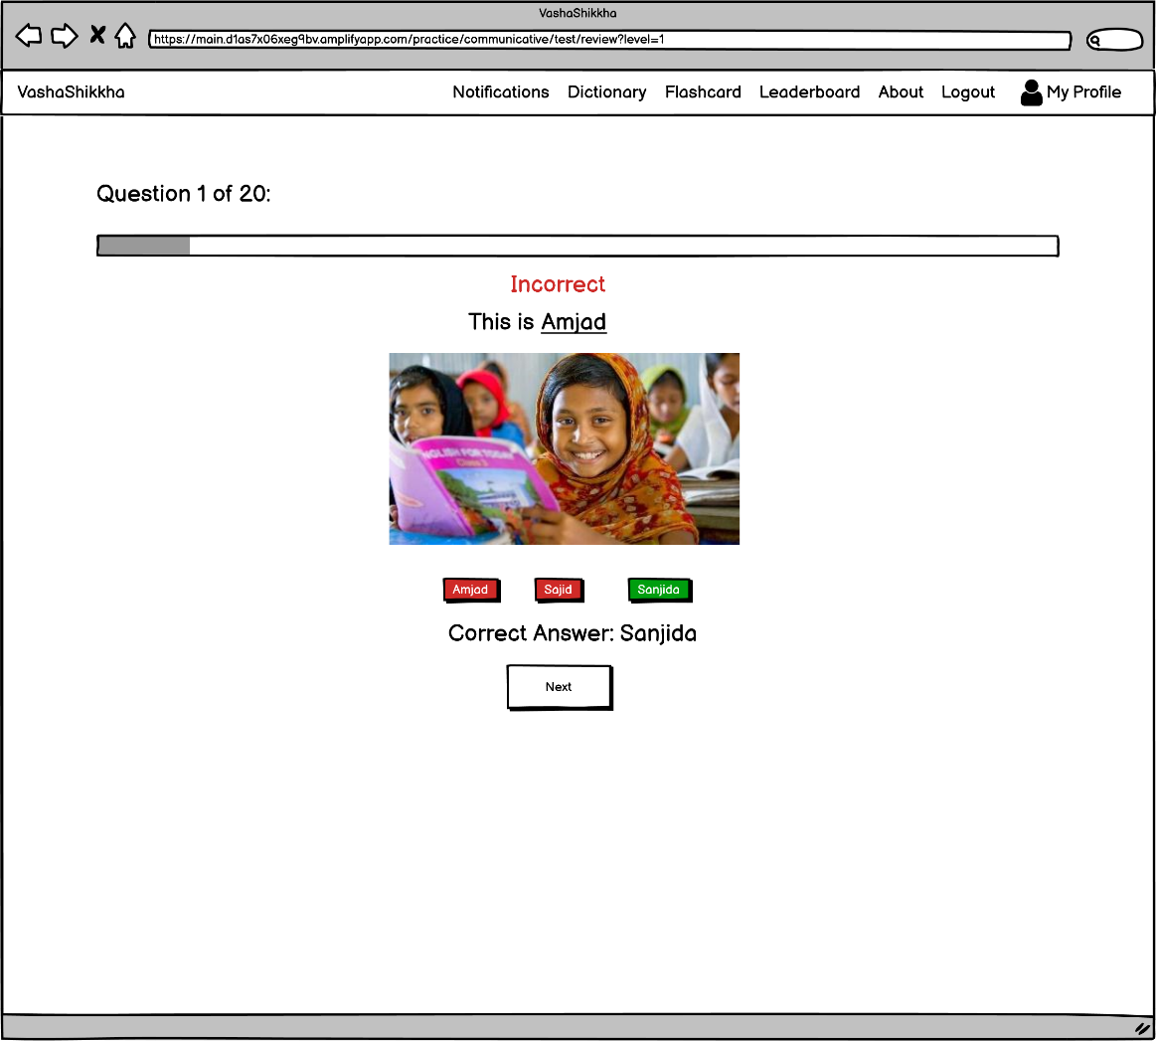
Level Based Test : Review

Slide 25
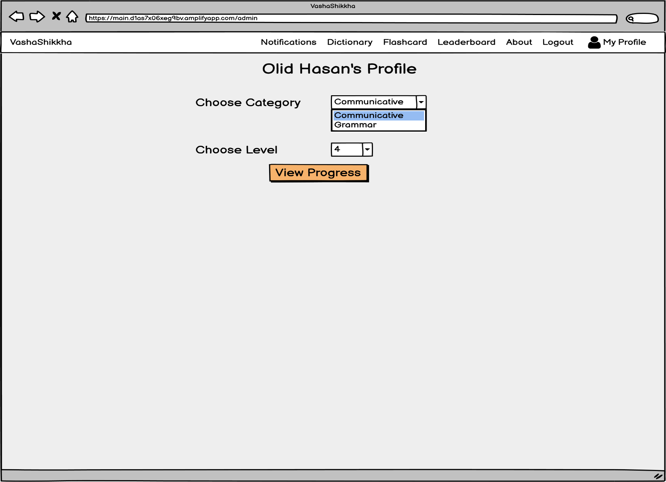
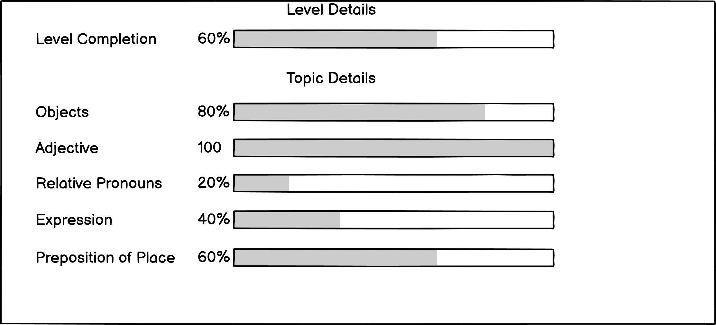
User Profile

Slide 26
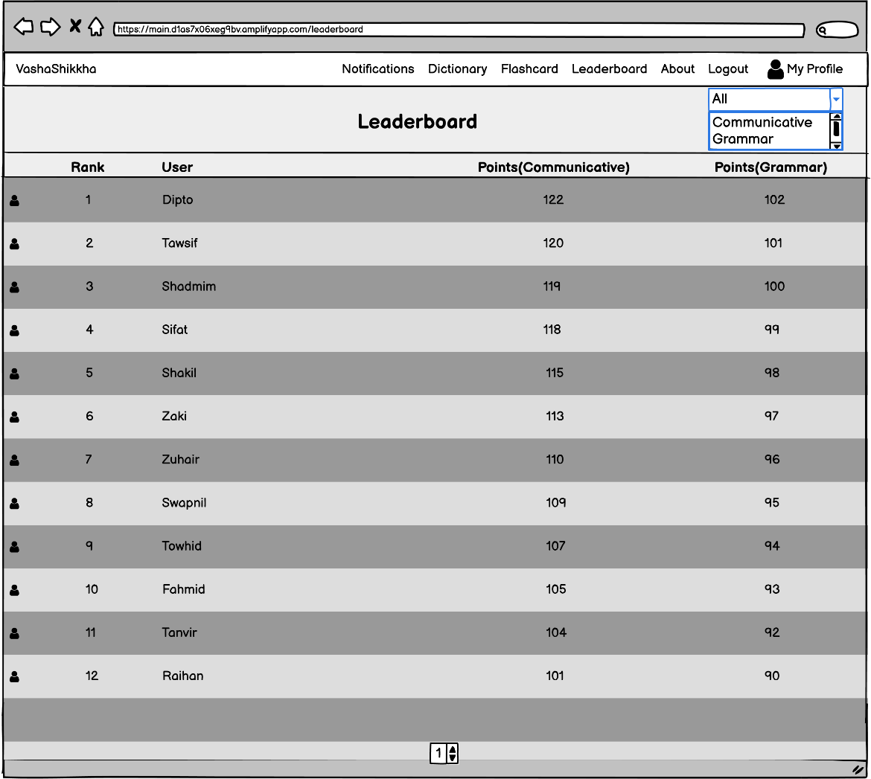
Leader Board

Slide 27
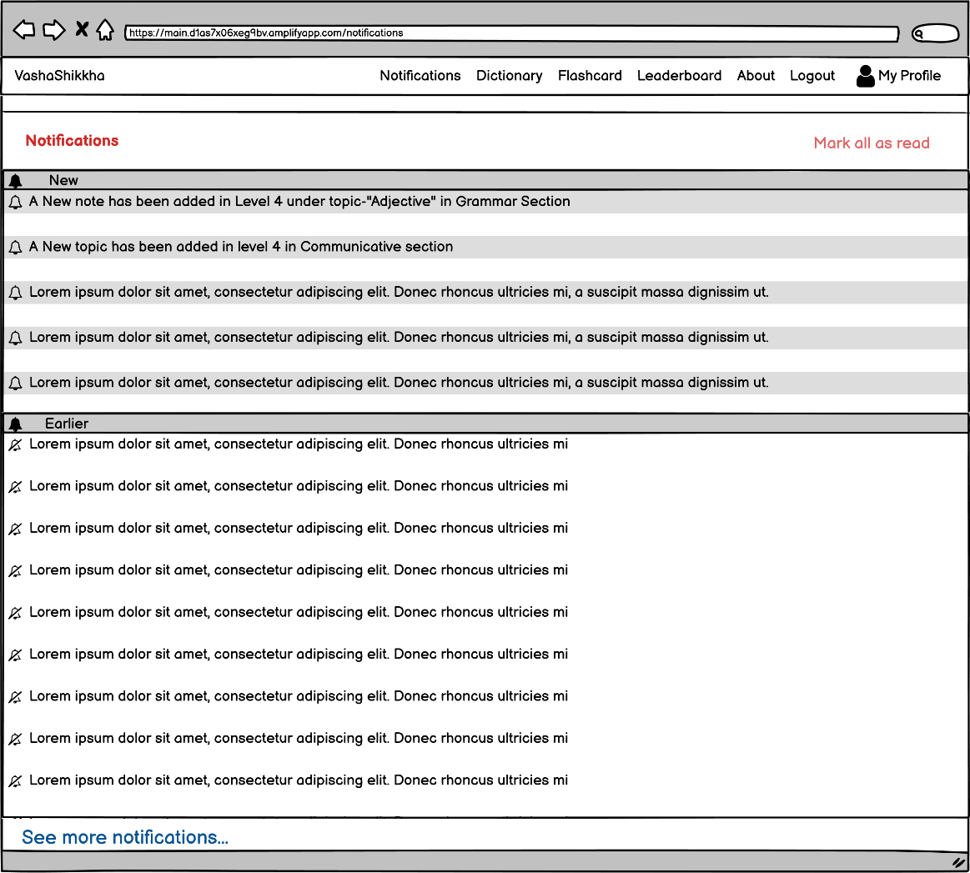
Notifications

Slide 28
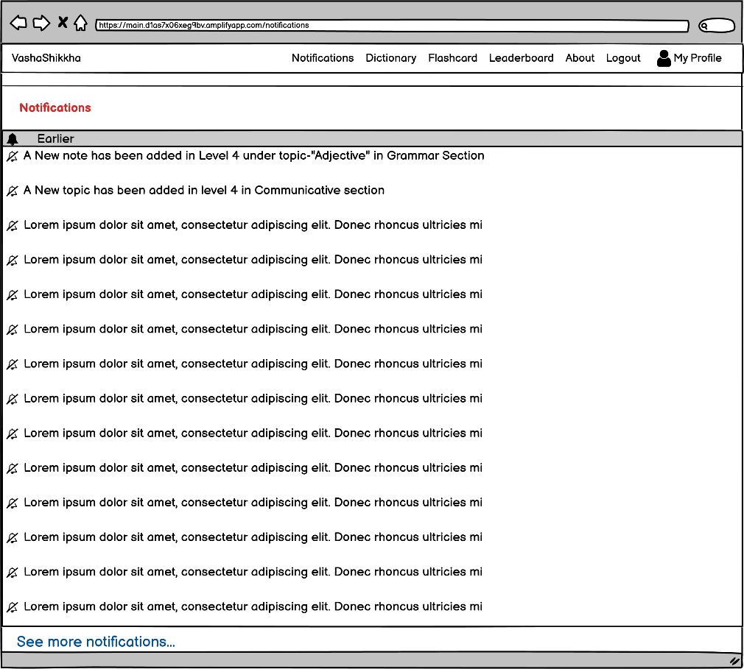
Notifications Marked

Slide 29
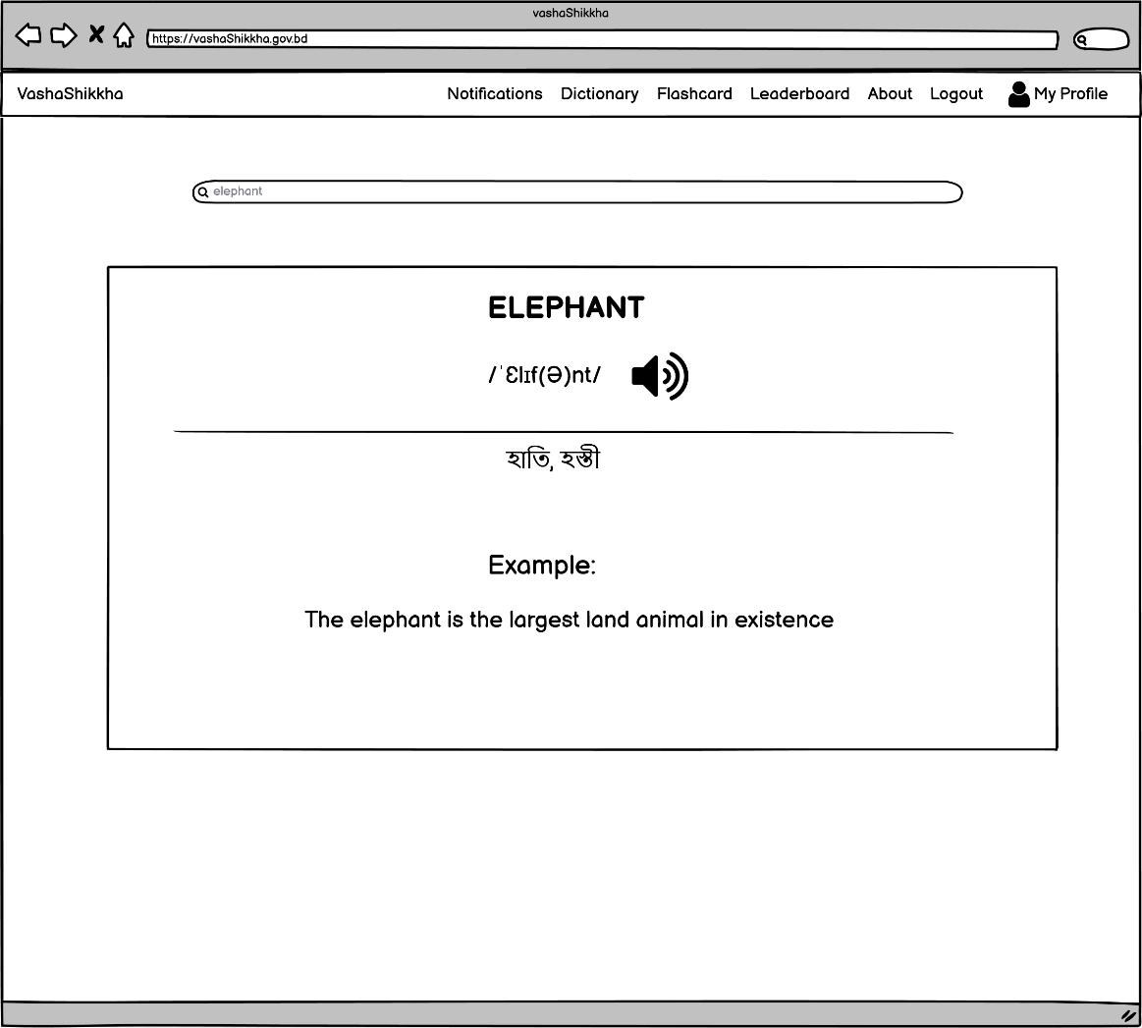
Dictionary Search

Slide 30
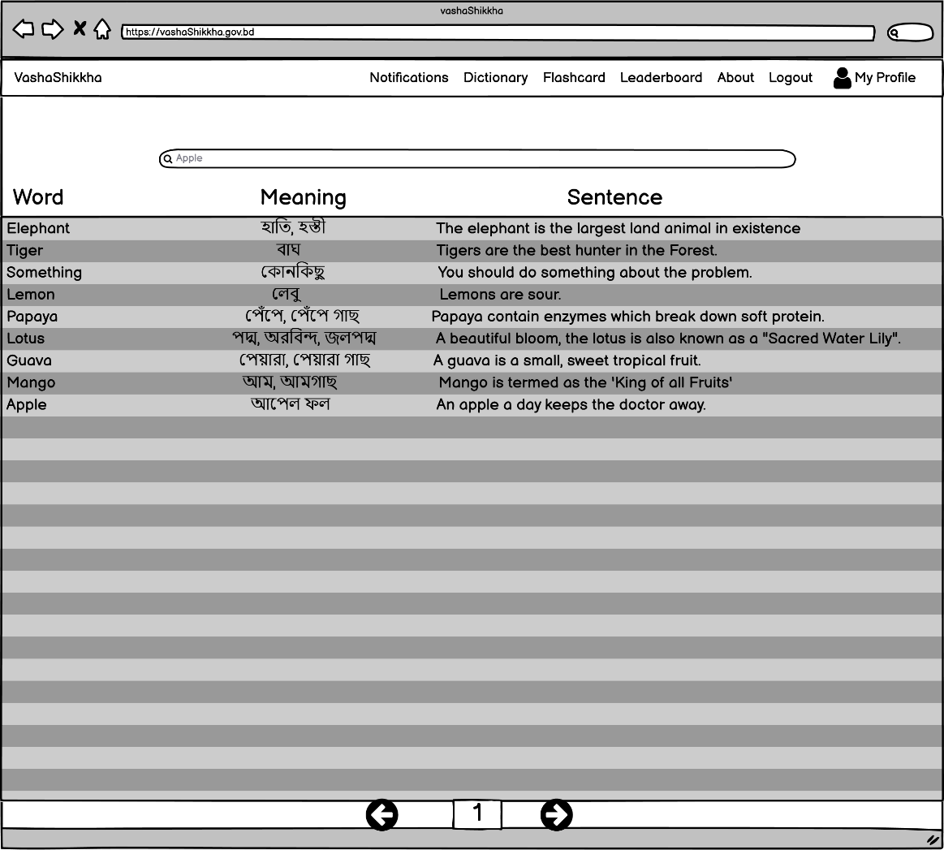
Flashcard

Slide 31
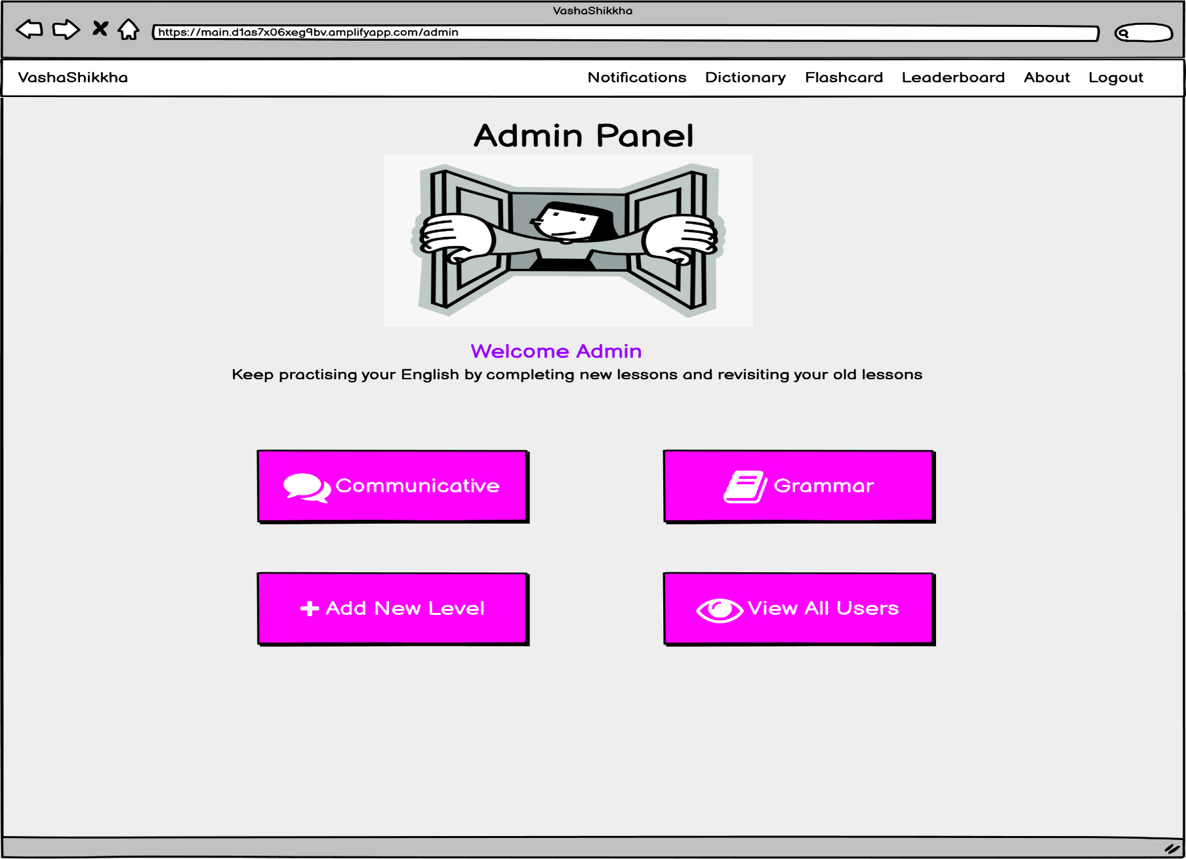
Admin Home

Slide 32
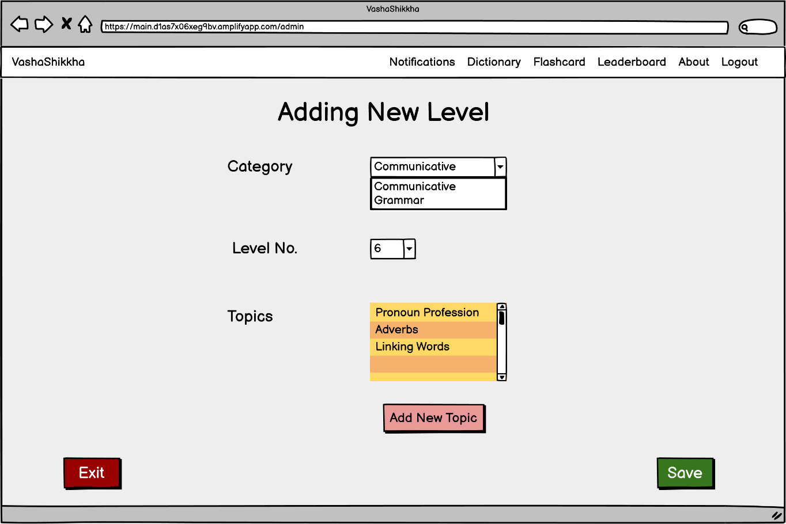
Adding New Level

Slide 33
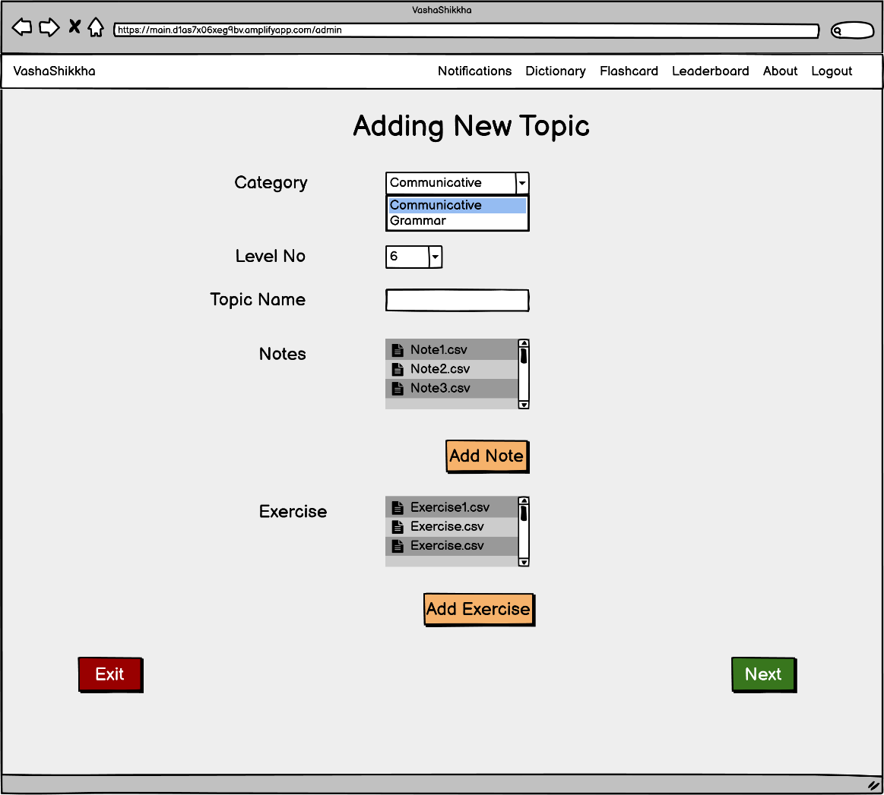
Adding New Topic

Slide 34
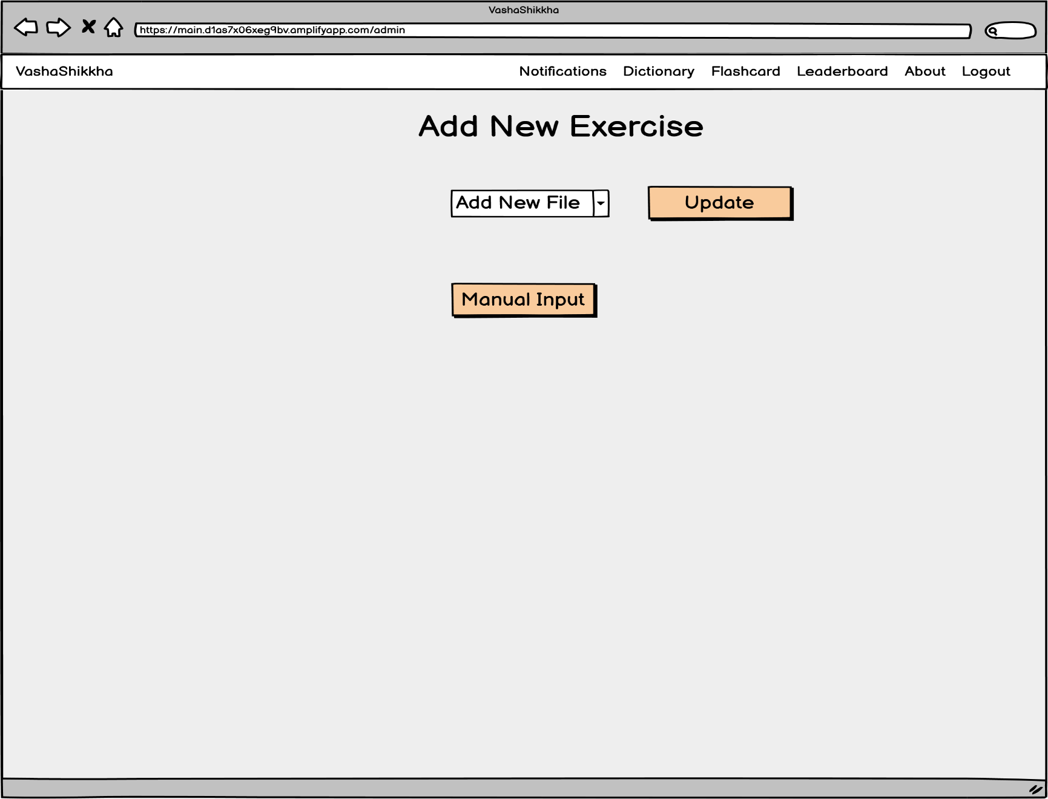
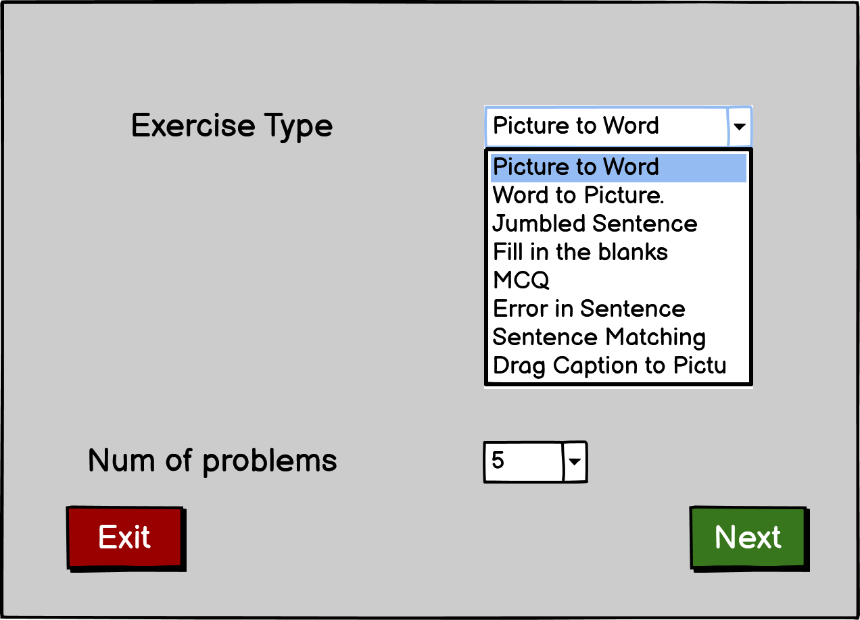
Adding New Exercise

Slide 35
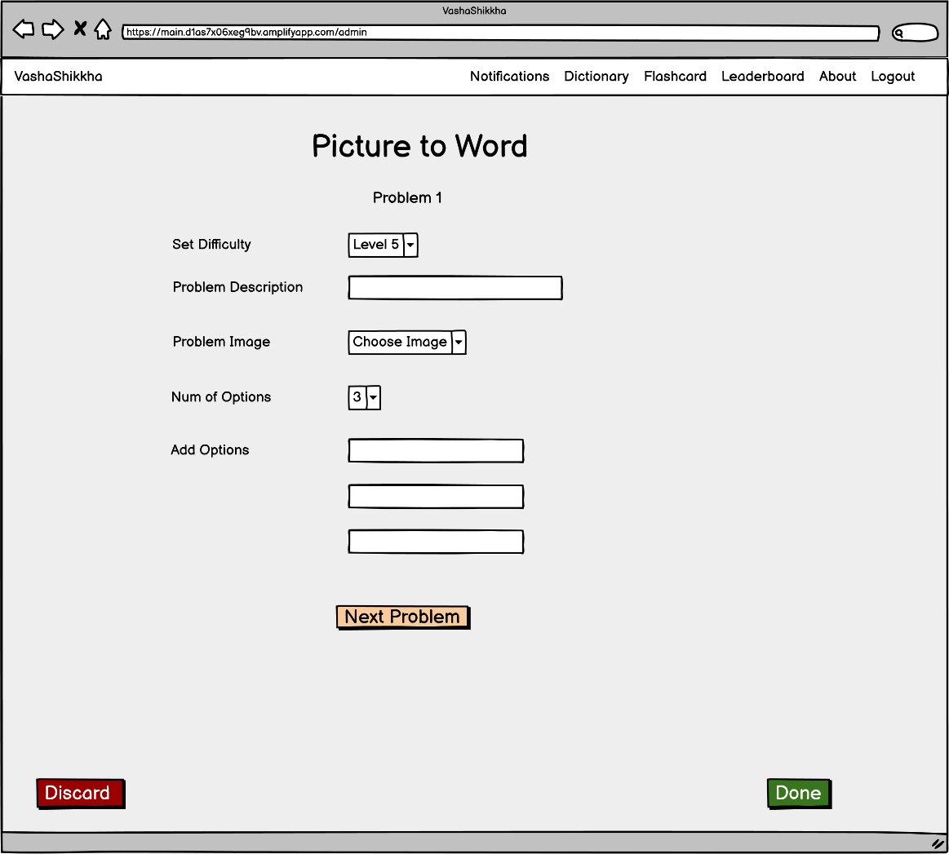
Exercise 1

Slide 36
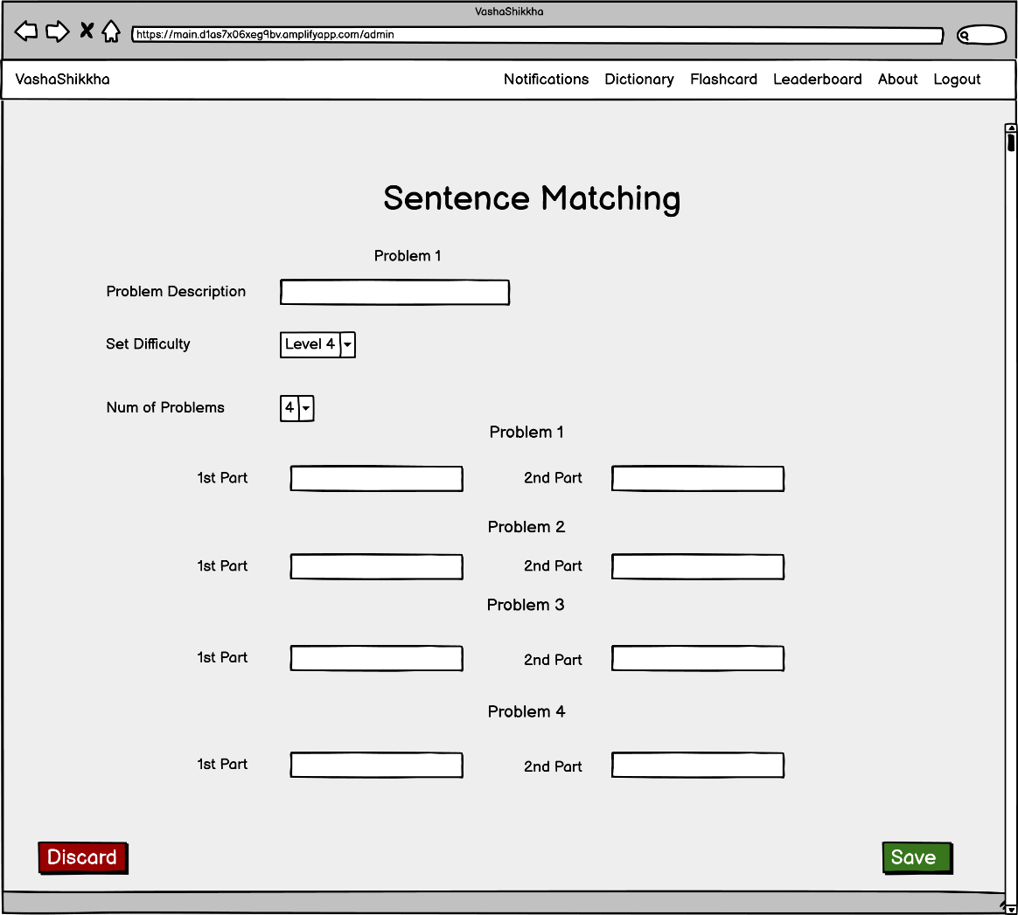
Exercise 2

Slide 37
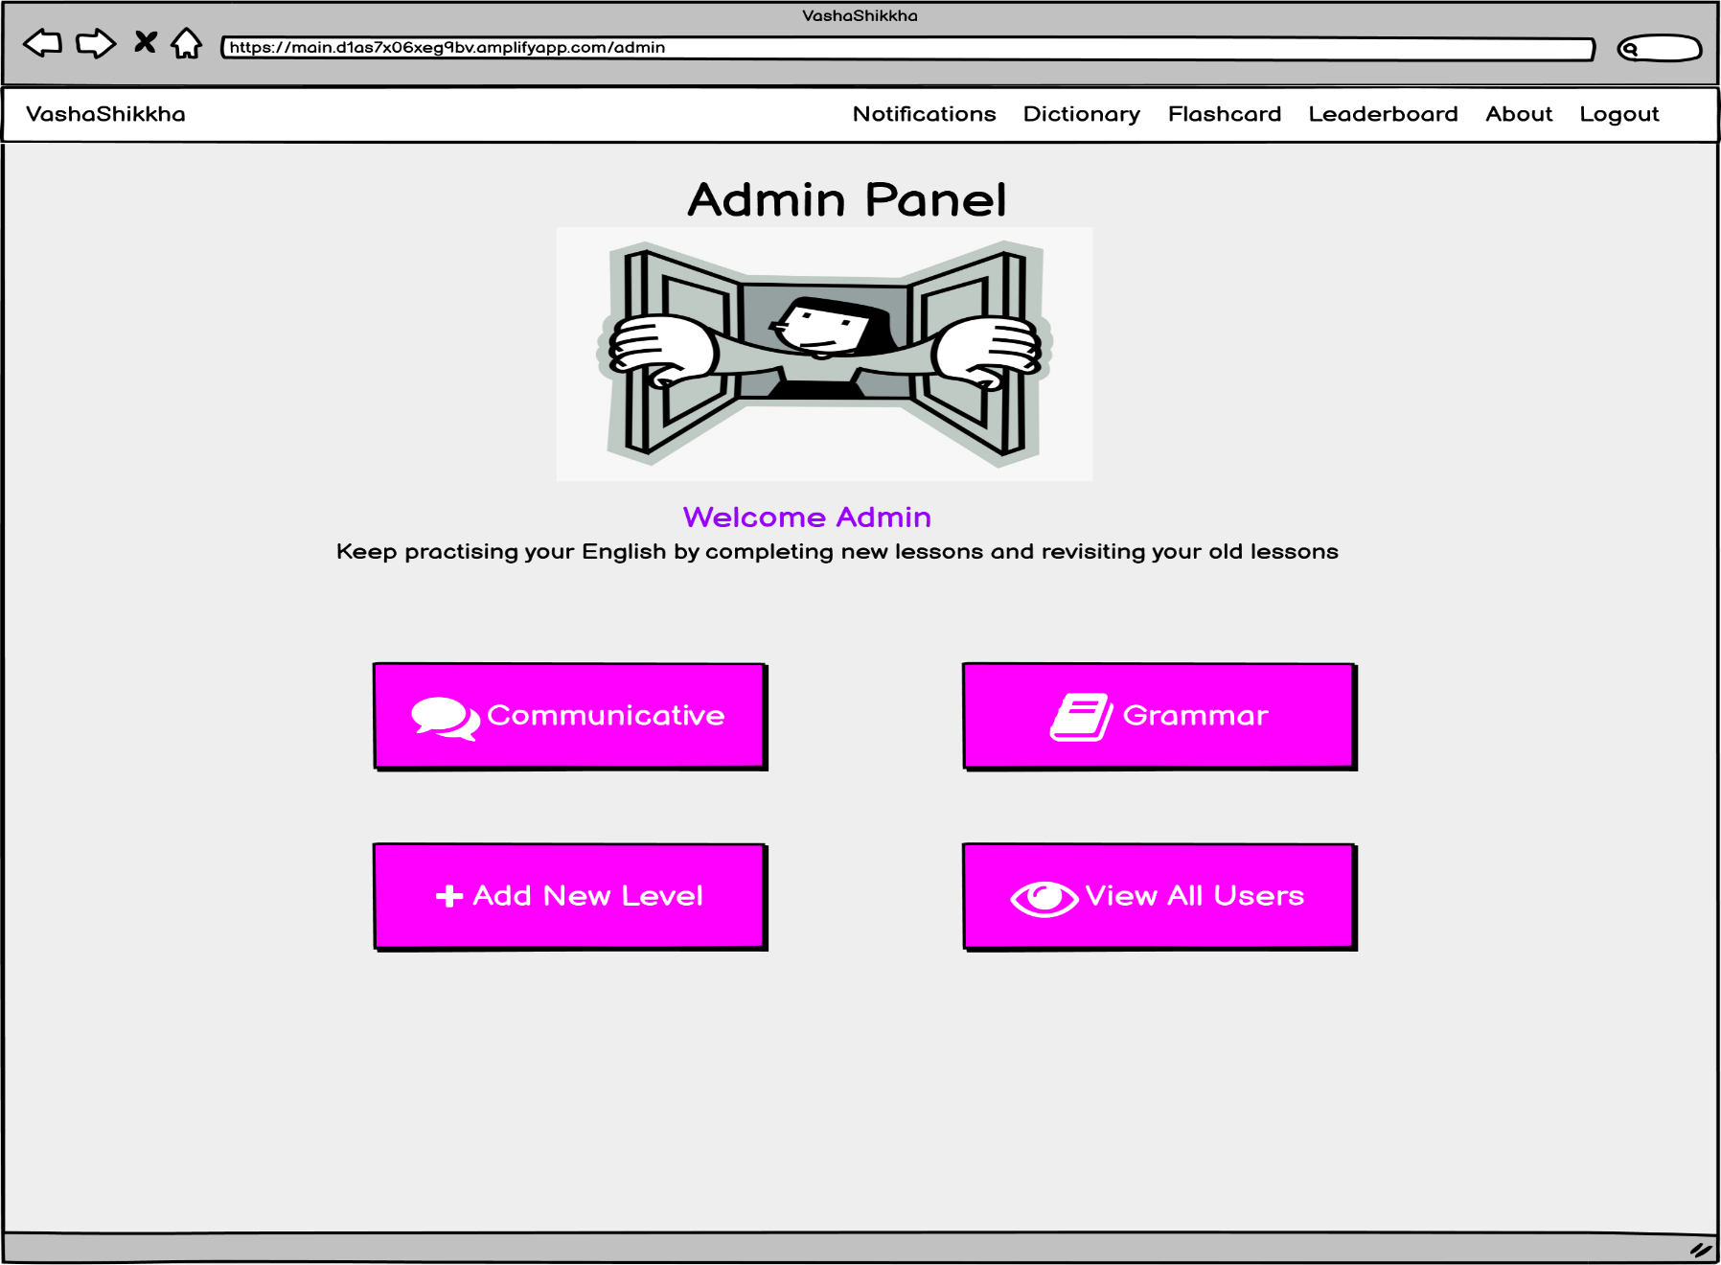
Admin Home

Slide 38
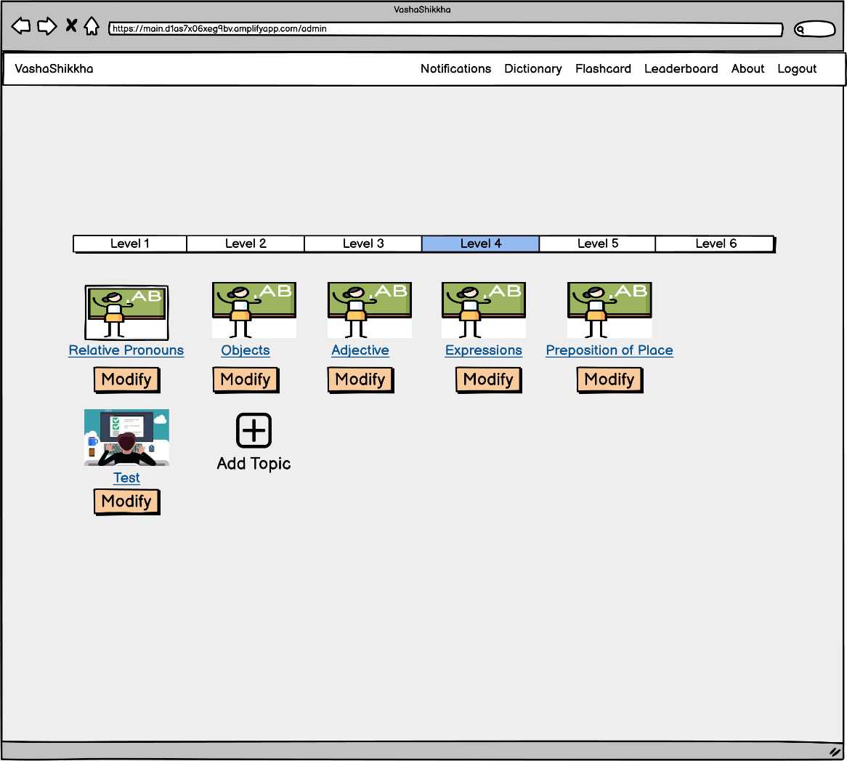
Modifying Level

Slide 39
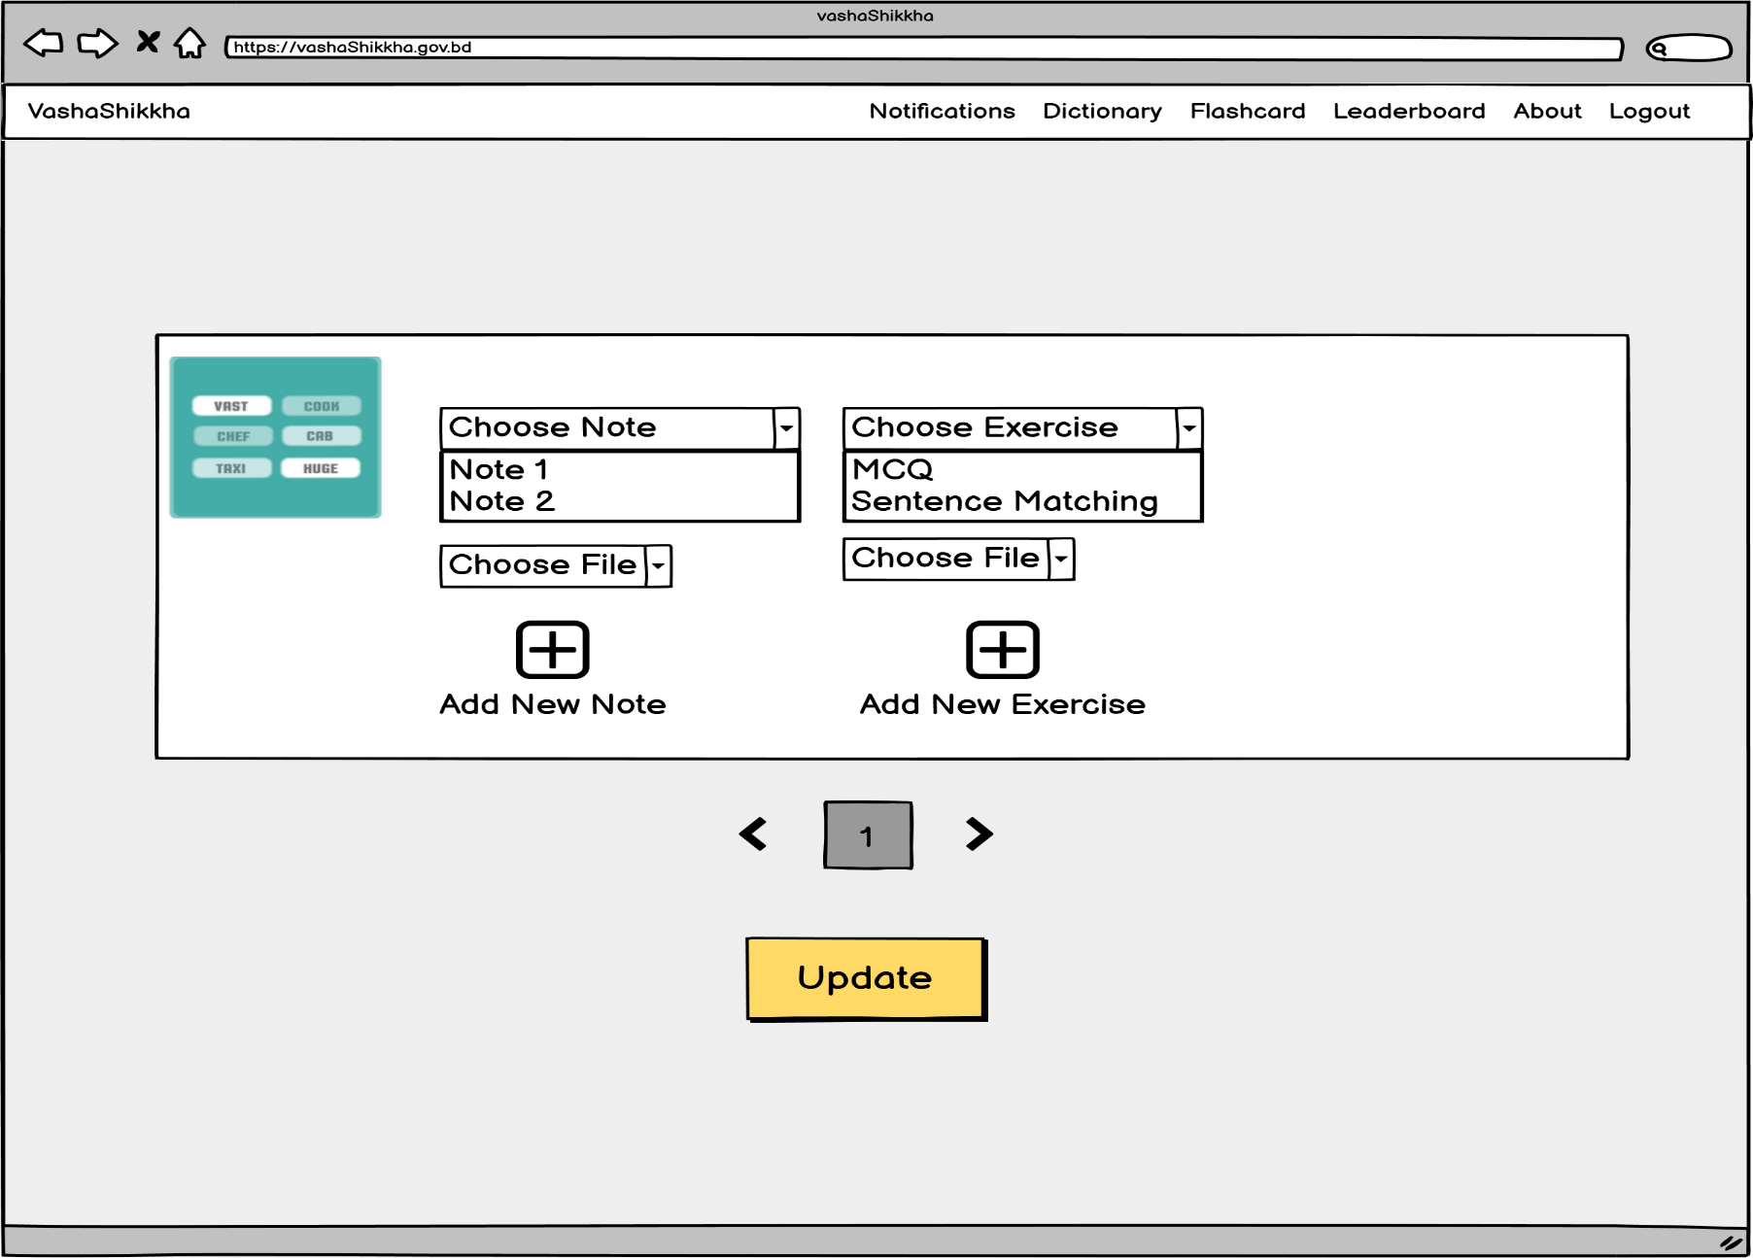
Modifying Topic

Slide 40
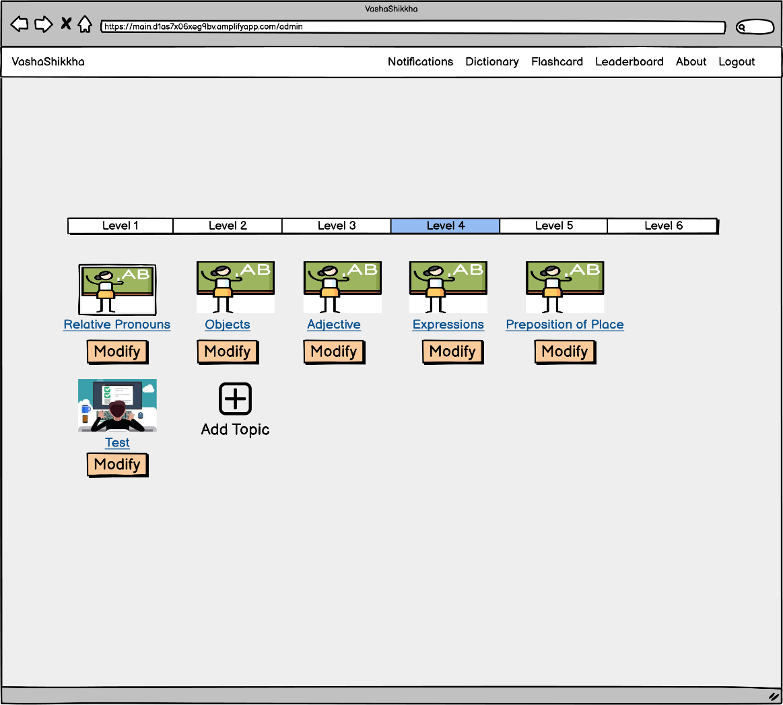
Modifying Test

Slide 41
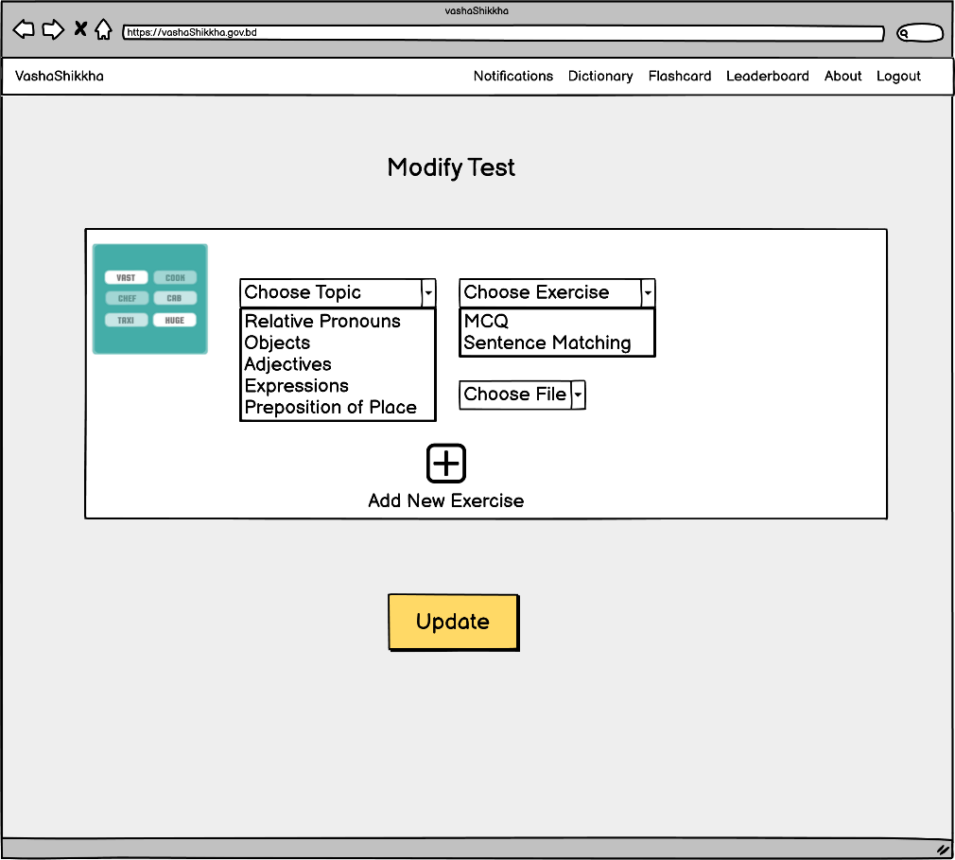
Modify Test

Slide 42

View All Users

Slide 43
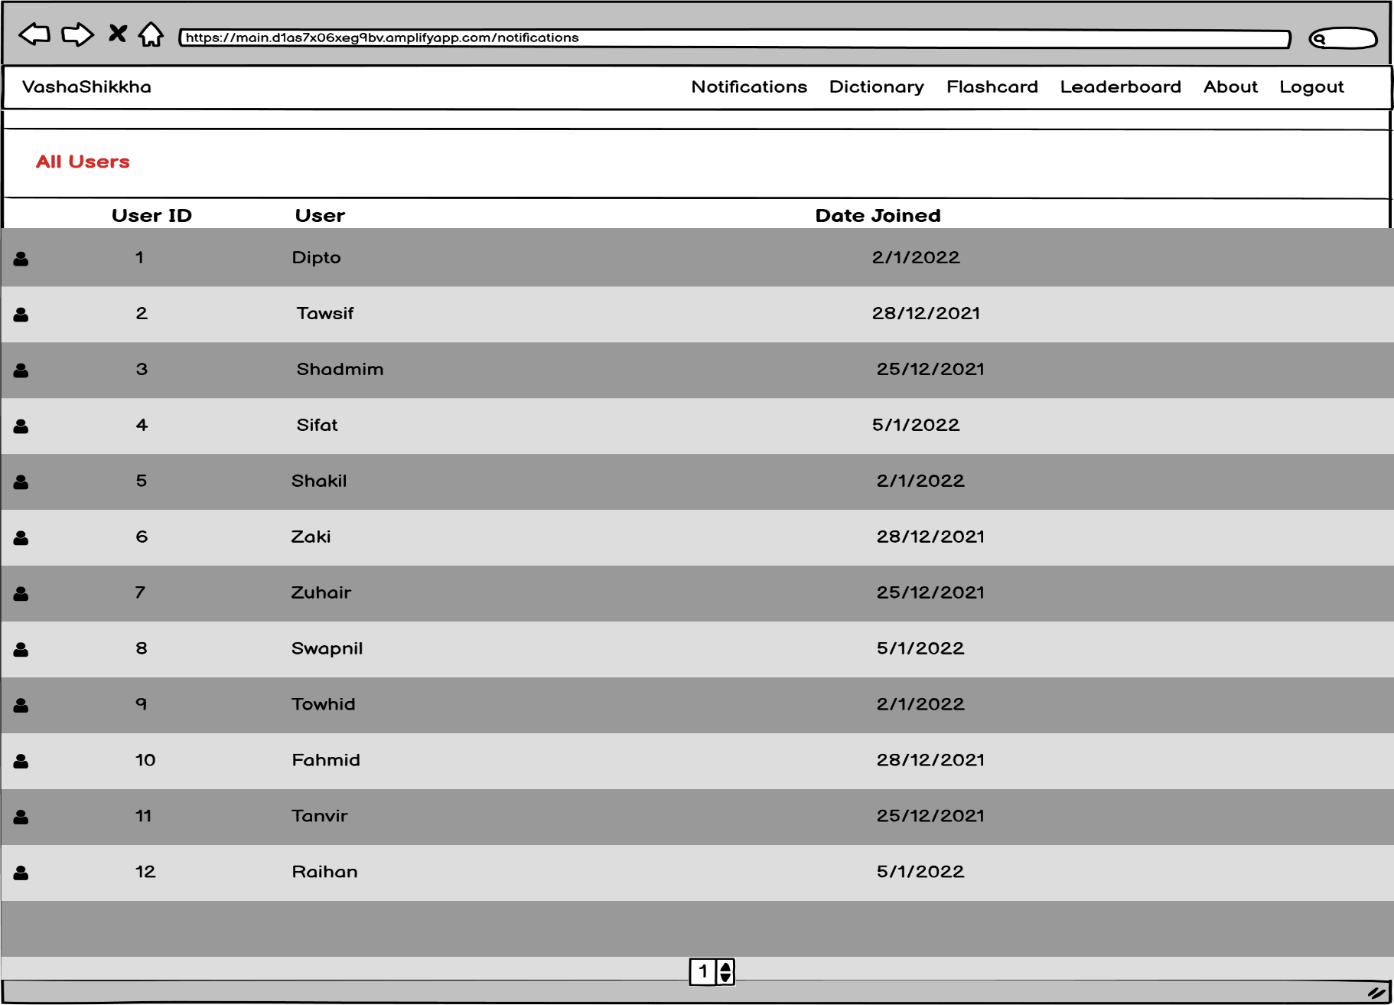
View All Users

Slide 44
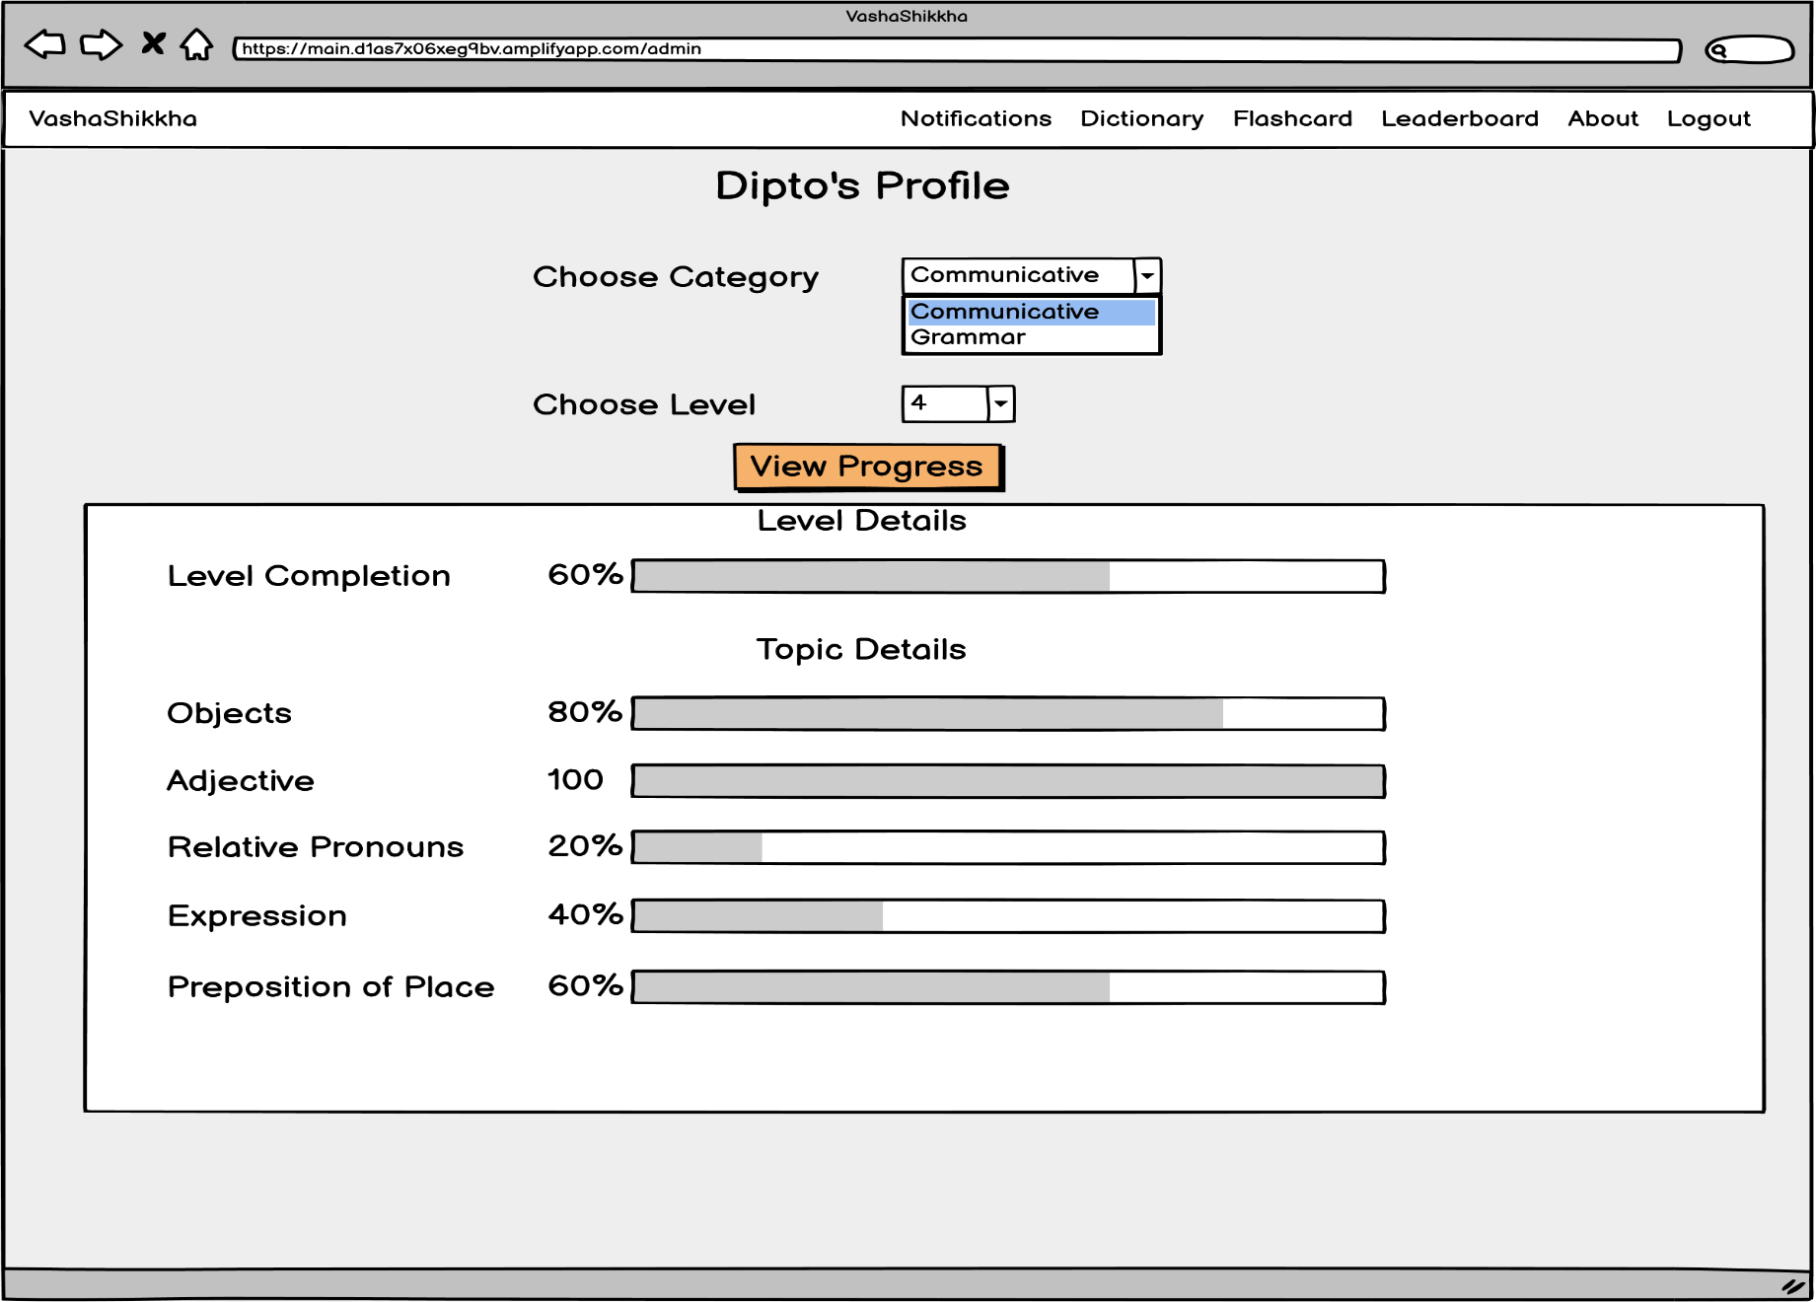
View User Profile

Slide 45


